Slide 1


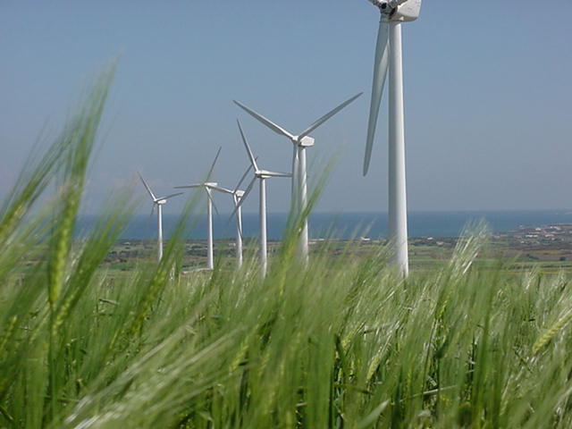
Republic of Tunisia
Ministry of Industry Mining and Energy
Renewable energy development in Tunisia
Abdelhamid KHALFALLAH, Director of Energy Transition

Slide 2
PLAN
Energy situation in Tunisia
Energy transition strategy in Tunisia
Regulatory Framework for RE
Targets of the Tunisian Solar Plan
Program 2017-2020 and main achievements,
Outlook

Slide 3
NATIONAL ENERGETIC STATUS

Slide 4
PRIMARY ENERGY RESOURCES
(1990-2035)
Deficit
Excess
deficit85%

Slide 5
GAZ: DEMANDES ET RESSOURCES
(1990-2035)
Demande Gaz pour prod élec
Gas Demand excluding electricity production
Déficit since 2005
Gas Resources

Slide 6
INTERNATIONAL STATUS

Slide 7
Fluctuation of international oil prices

Slide 8
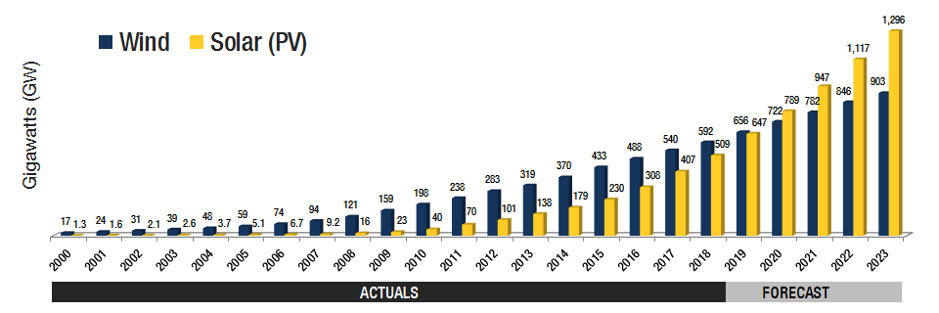
Global wind and solar PV market evolution
Global Wind & Solar Installations in Gigawatts (GW) | Go to top of page
Global Cumulative Installations 2000-2023e

Slide 9
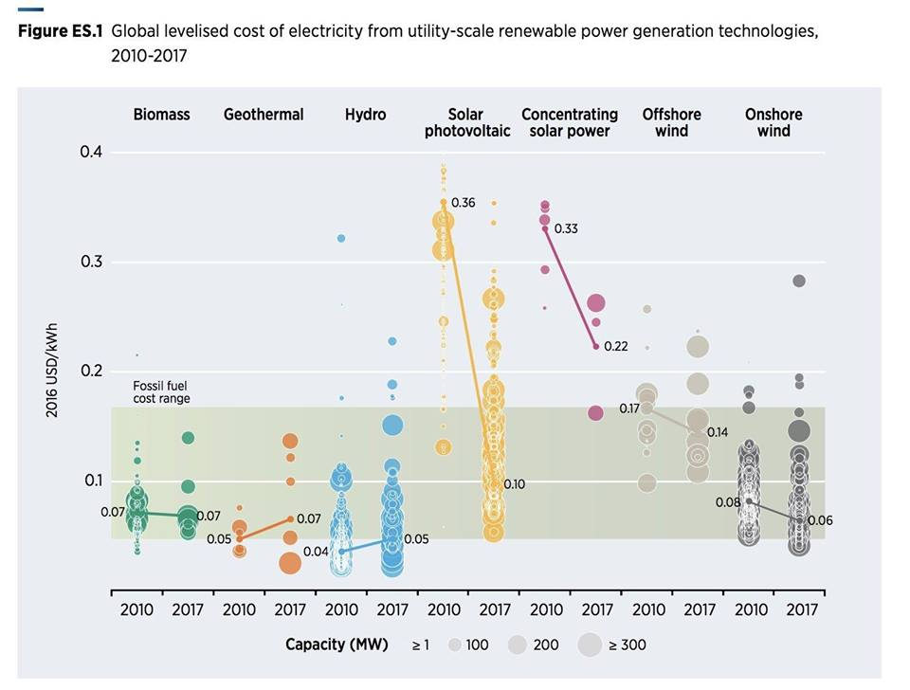
RE prices evolution on the world market
Source IRENA

Slide 10
ENERGY TRANSITION IN TUNISIA

Slide 11
New Energy Transition
Development of energy efficiency
Diversification of the electricity mix and decentralization of electricity production through the integration of renewable energies
Strengthening the conventional (oil and gas)
Rationalization of the energy subsidy
Regional integration of the electricity sector:
Strengthening interconnections

Slide 12
RENEWABLE ENERGY DEVELOPMENT

Slide 13
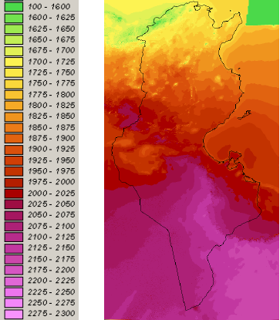
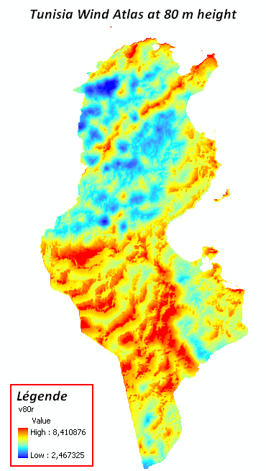
Potential of Renewable Energies in Tunisia
  Solar
  Wind
  Solar water heating : 4 Millions m²
  Electricity production: 900 GW
  Electricity production: 8 GW

Slide 14

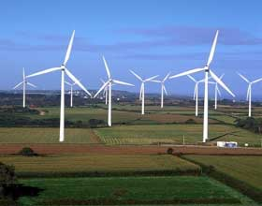
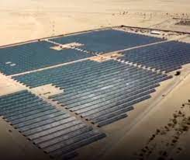
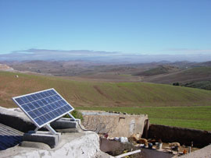
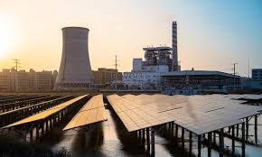
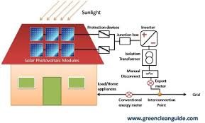
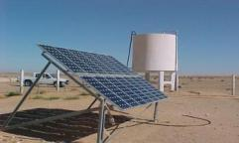
Main Achievements
1 million m²
of SWHs
STEG: 245 MW wind and 20MW PV
Hydraulique: 65 MW (limité)
14 000
rural households
Rural schools
…
50 MW of self consumption PV stations (MHV)
130 MW of roof tops PV systems
130 water pumping stations

Slide 15
NEW REGULATORY FRAMEWORK FOR RENEWABLE ENERGY

Slide 16
  Law n°2015-12 of may 11, 2015
Concession regime
Exportation
Local market
Autorisation regime
Local market
Self-consumption
Authorization
Prior agreement + operating license
Concession
After call for competition
Concession
After call for competition
Electricity generation from RE

Slide 17
Regulatory framework (1)
  Concession regime
Power > 10 MW for PV
> 30 MW for wind
In the first tender the land chosen by the Ministry (wind & PV) or proposed by developer (wind).
Calls for tenders in 2 phases:
1) pre-qualification tender
2) restricted tender
Tariffs in foreign currency ($ & €) with a share in local currency.
Selecting the best offer (lowest tariff).

Slide 18
Regulatory framework (2)
  Authorization regime
Power <= 10 MW in PV
<= 30 MW in wind power
Lands chosen by the developers
Calls for projects specifying the overall capacity for each technology
Counting of offers in 2 steps:
  financial : classify the offers according to the proposed prices,
  technical : min 50pts/100 to be accepted.

Slide 19
Cadre réglementaire
  Self consumption Medium/High Voltage
Unlimited installed capacity but at least 70% of electricity produced must be self-consumed (max excess 30%)
Authorization given by the Minister of Energy
Creation of a local network of suppliers / installers

Slide 20
Cadre réglementaire
  Self consumption Low Voltage
  (Prosol-Elec project)
Installed capacity <= subscribed power
Creation of a local network of suppliers / installers
Establishment of a financing mechanism (credit line of 180MD with guarantee of payment by the national company of electricity STEG)
The supplier is the main vis-à-vis customer for the realization of his installation.

Slide 21
TARGETS

Slide 22
GLOBAL TARGETS OF THE TUNISIAN
SOLAR PLAN
22% of electricity produced by RE in 2023
30% of electricity produced by RE in 2030
RE share in the electricity mix
Installed cumulative ER power (MW)
12%
Global investment of around 4 billion US$ by 2030

Slide 23
PROGRAM 2017-2022
(program 2017-2020 updated in 2018)
MW
Programme révisé (2018) |  | Régime
PV | Eolien
500 | 500 | IPP | Concessions
140 | 130 | Appels à projets | Autorisations
130 | 80 | Demandes spontanées | Autoproduction
300 | 80 | EPC | STEG
1070 | 590 | Total
1860

Slide 24
IMPLEMENTATION OF THE TUNISIAN SOLAR PLAN
Authorization regime

Slide 25
Results of round 1 to 4
N° Appel à projet | Nbre d’offres | Nbre autorisations | Puissance (MW) | Tarif moyen
 |  |  |  | c$/kWh | Mill/kWh
1 | 37 | 6 | 60 | 5 | 158
2 | 22 | 6 | 60 | 4,5 | 131
10MW PV
3 | 16 | 6 | 60 | 4,4 | 128
4 |  | 6 | 60 | 4,1 | 118

Slide 26
Results of round 1 to 4
N° Appel à projet | Nbre d’offres | Nbre autorisations | Puissance (MW) | Tarif moyen (mill/kWh)
1 | 22 | 4 | 4 | 210
2 | 23 | 10 | 10 | 211
1MW PV
3 | 19 | 10 | 10 | 202
4 |  |  | 10 | 180
N° Appel à projet | Nbre d’offres | Nbre autorisations | Tarif moyen (c$/kWh)
2 | 9 | 4 | 4,5
Eolien

Slide 27
IMPLEMENTATION OF THE TUNISIAN SOLAR PLAN
Self-consumption regime

Slide 28
Ashievements for low voltage
130MW by end 2021
→ New reform of the financing mechanism since 2022

Slide 29
Ashievements for medium/high voltage
more than 270 authorizations for total power of 50 MW.
New ongoing regulatory reforms:
revision of the counting system (Contract),
New grid code ongoing

Slide 30
IMPLEMENTATION OF THE TUNISIAN SOLAR PLAN
Concession regime

Slide 31
Goals 2017-2020
PV
 | Capacity MW | Gouvernorate
Tunisian solar plan | 100 | Sidi Bouzid
 | 100 | Gafsa
 | 50 | Tozeur
 | 50
Project Sahara | 200 | Tatouine
500MW

Slide 32
Goals 2017-2020
Wind
 | Puissance MW | Gouvernorat
Land given by the Ministry | 200 | Nabeul
 | 100 | Kebili
Land proposed by the investor | 200
500 MW

Slide 33
Pre-qualification tender
Published on May 23, 2018
800MW PV and wind with land proposed by the Ministry: 59 offers received → selection of 16 candidates for PV and 12 for wind,
200MW wind for the land proposed by the investor: the bid will be reviewed

Slide 34
Retricted tender: Solar PV
500MW PV with land proposed by the Ministry: projects valideted by laws in the end of 2021:
      - Tozeur: SCATEC/50MW 79,379 mill/kWh
      Sidi Bouzid: SCATEC/50MW 79,379 mill/kWh
      Tatouine: SCATEC/200MW 71,783 mill/kWh
      Gafsa: ENGIE/NAREVA 100MW 79,950 mill/kWh
      Kairoun: TBEA/AMEA 100MW 97,720 mill/kWh

Slide 35
Retricted tender
300MW wind with land proposed by the Ministry:
    wind speed measuring will be launched in the next months
    Offers will be received in the end of 2023

Slide 36
Green Hydrogen
A new cooperation project with GIZ is ongoing to:
Implement a pilot project : grant of 25MEuros
Technical assistance to prepare a road map and a national strategy for green hydrogen

Slide 37
Electrical mobility
interesting new measures in the 2022 finance law : removal of all tax and customs barriers for electric cars (law n°2021-21 article 30).
STEG will prepare a new regulatory framework for charging stations

Slide 38
Outlook (1)
New program 2022-2025: 2500MW in global on which 1500MW large scale projects by concession regime,
2022: concession regime:
  2x150MW of PV with land proposed by the government
  2X100MW of PV with land proposed by developer
  2X75MW of wind with land proposed by the government
2022: authorization regime: a call for projects for 70MW PV (6 projects of 10MW and 10MW of 1MW)

Slide 39
Outlook (2)
New strategy for green hydrogen
Electrical mobility development
Creation of a regulation authority
RE code ongoing

Slide 40
thank you for your attention

