Slide 1
Virtual Conference
Future Technologies in Tunisia
Opportunities for Investors in Tunisia’s Tech Sector
Presented by Ms. Saida KAHOULI
Director Germany, Invest In Tunisia Agency « FIPA
March 30, 2022

Slide 2
SUMMARY
01
FDI Landscape in Tunisia: Key Figures
Major Assets of Tunisia
02
03
Business Opportunities in Tunisia
04
Invest in Tunisia Agency Missions

Slide 3
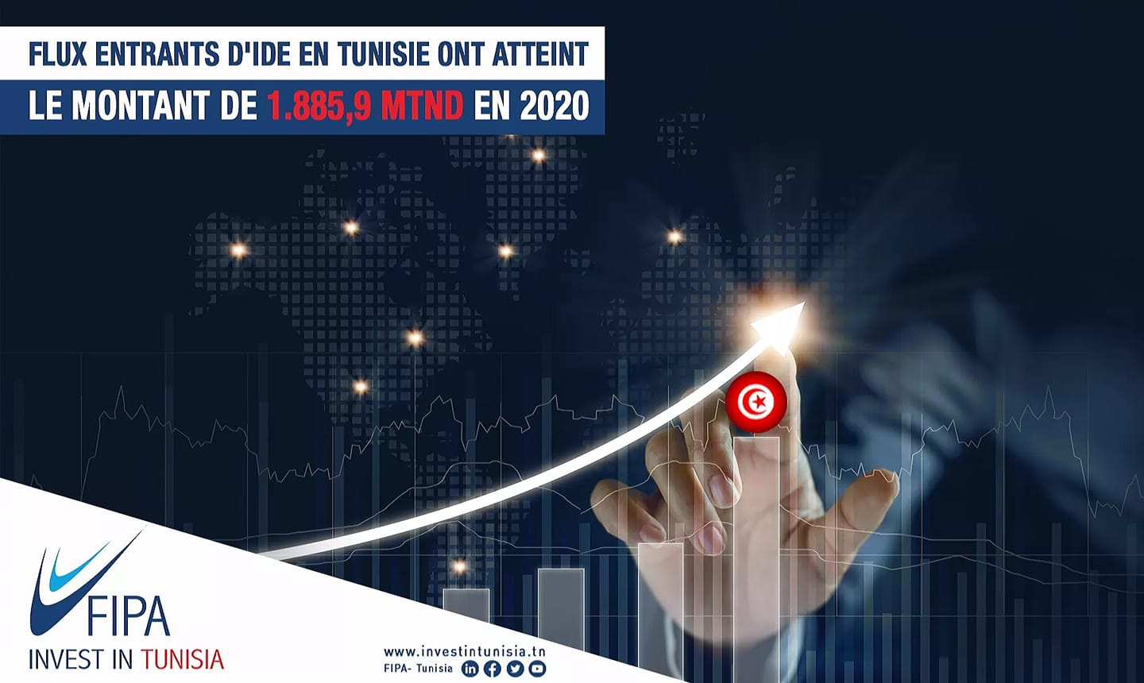
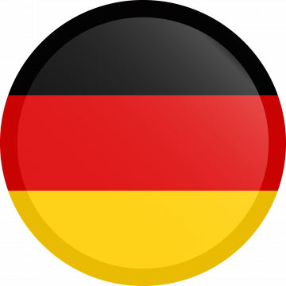
FDI Landscape in Tunisia: Key Figures
er
+ 3 700
Foreign Companies
284 German companies
80 % are wholly exporting
57 companies are in Mechanical,
Electrical and Electronic Industry
29 479 MTND
+ 1 800,0 MTND
+ 416 000 jobs
+ 77 000 Jobs
Source: FIPA-Tunisia
1 TND = 0,31 Euros (December 2021)

Slide 4
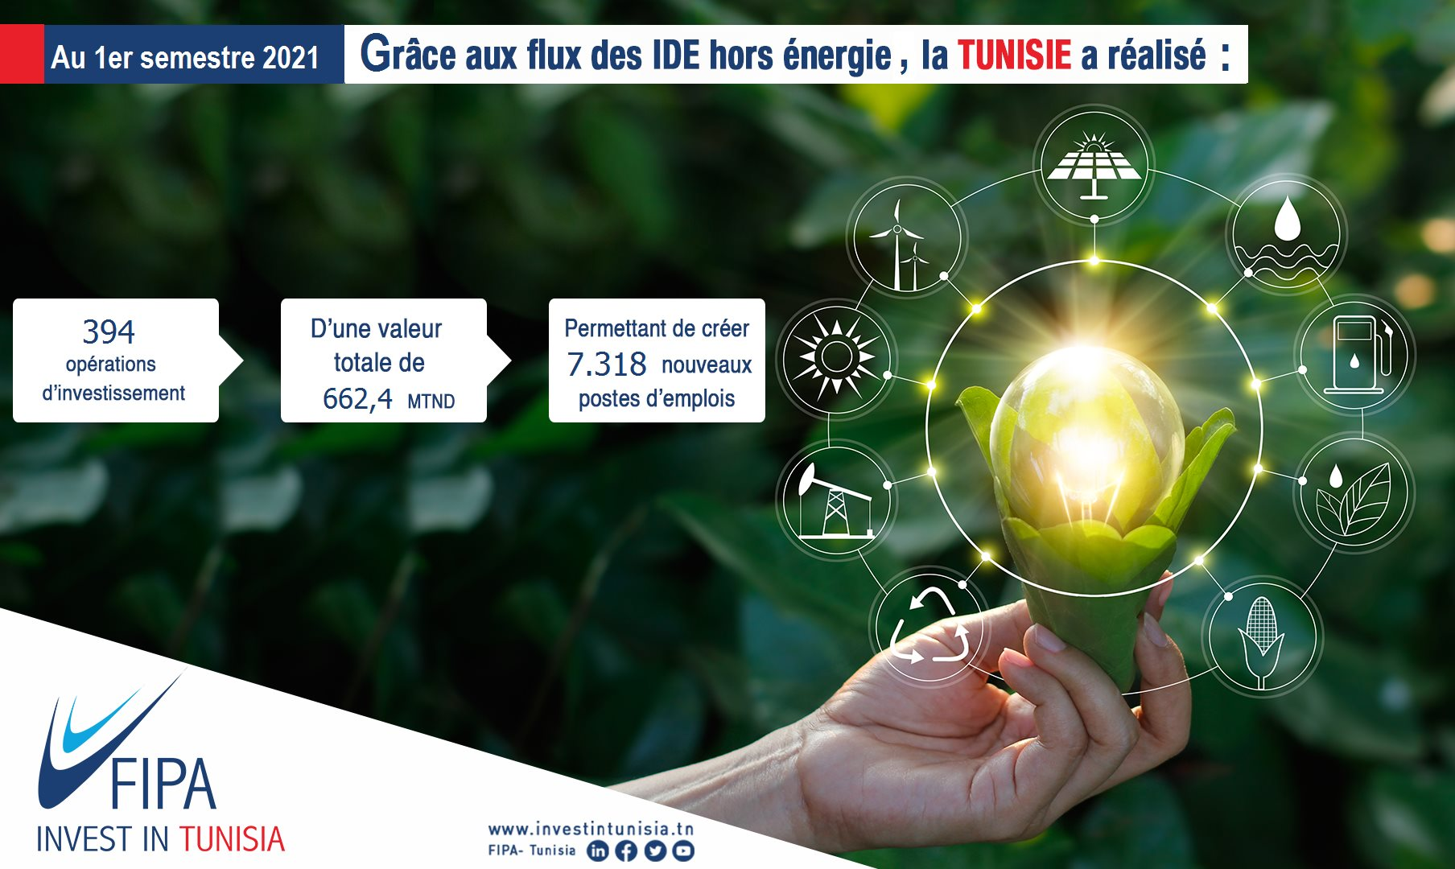
TUNISIA has the competitiveness to attract more Foreign Investment. It recorded:
In 2020
517 Investment Operations, with a Total Value of 1213.8 MD, creating 9630 Direct Jobs.
At the End of September 2021 :
452
Investment Operations
960,8 MD
Investment Amount
8904
New Jobs
Source: FIPA-Tunisia
1 TND = 0,31 Euros (December 2021)
35 Investment Projects
+ 3000 Jobs
At the End of September 2021

Slide 5
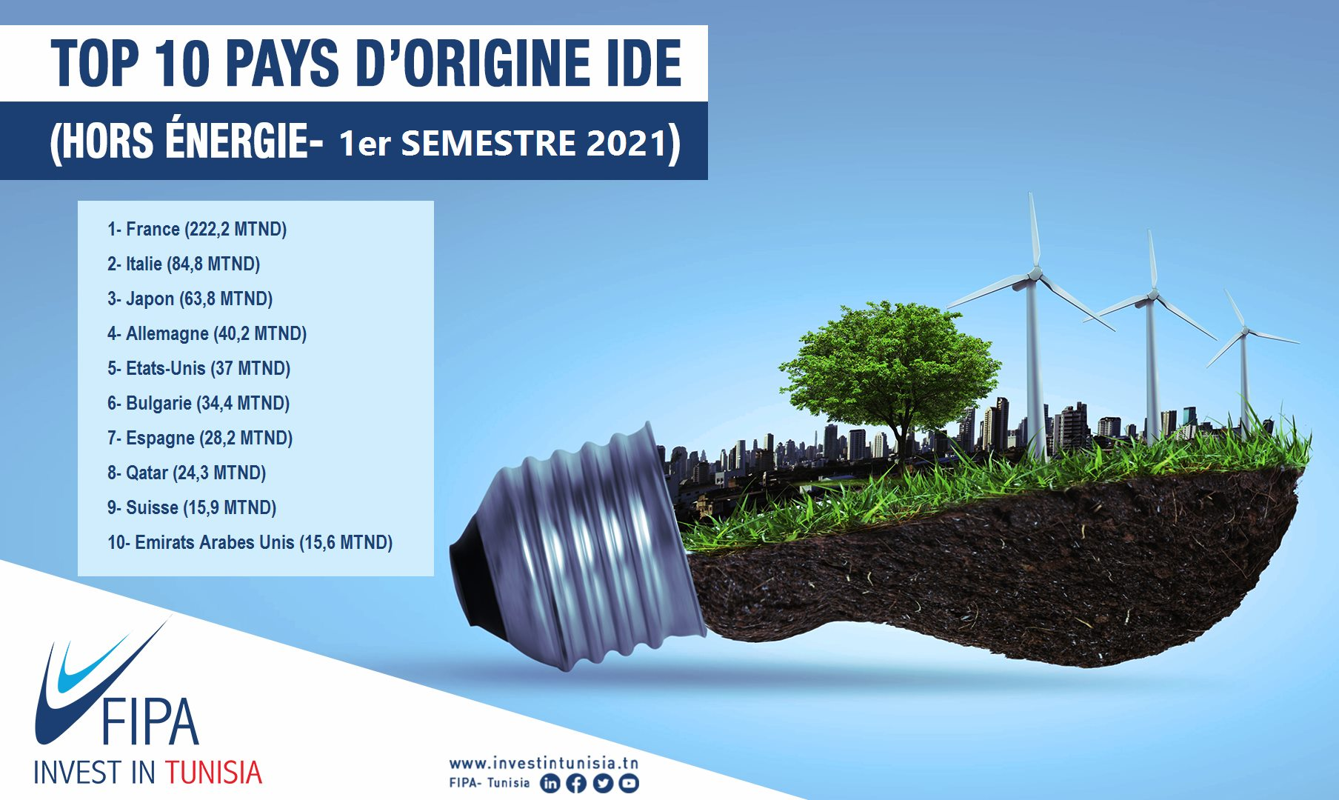
GERMANY IS AMOUNG TOP 5
TOP 5 PAYS D’ORIGINE IDE
OF LEADING ISSUING COUNTRIES OF FDI (First 9 Months of 2021)
1- FRANCE (319,5 MTND)
2- ITALY (127,2 MTND)
3- SPAIN (74,8 MTND)
4- JAPAN (67,1 MTND)
5- GERMANY (63,4 MTND)

Slide 6
SUMMARY
01
FDI Landscape in Tunisia: Key Figures
Major Assets of Tunisia
02
03
Business Opportunities in Tunisia
04
Invest in Tunisia Agency Missions

Slide 7



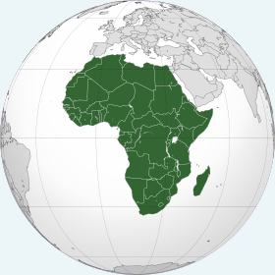
TUNISIA: The Access Point to the African Market
A geostrategic position in the Med Area at just an hour flight to Europe and less than three hours flight from Middle East Cities
Member of COMESA, a common Market for Eastern and Southern Africa with 625 Millions consumer
An advanced partner status with the European Union with a Deep and Comprehensive Free Trade Agreement (DCFTA) in Progress
Ongoing discussion to join The Economic Community of West African States (ECOWAS) with 325 millions consumers
Triangular Cooperation
Germany-Tunisia-Africa
offers itself to the
German companies targeting the African market through TUNISIA
Free trade agreement with Morocco, Egypt and
Jordan (AGADIR), and with
Turkey
Tunisia officially integrated AfCFTA in July 2020
A regional and international Integration including
52 agreements on double taxation and
54 bilateral agreements to promote and protect investments

Slide 8


2
Pool of International Level Talents …
+ 65 000 new graduates per year
About 1 200 vocational training institutions in more than 370 specialties
The greatest concentration of researchers among Arab and African countries
Source: Bloomberg Innovation Index, 2019
20 000 Rank A researchers

Slide 9
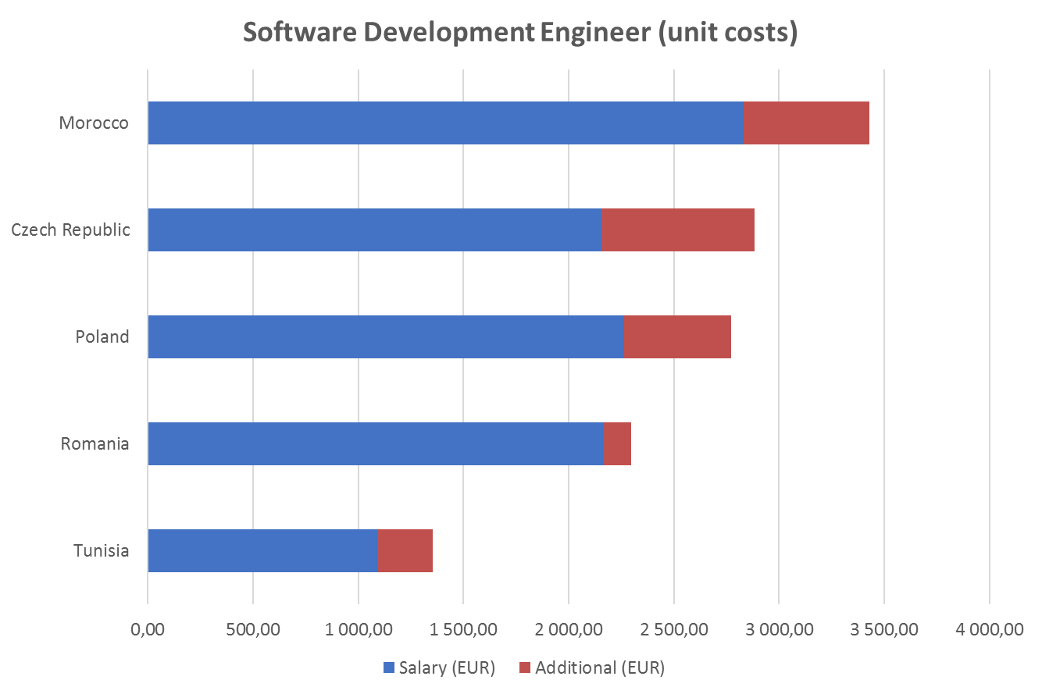
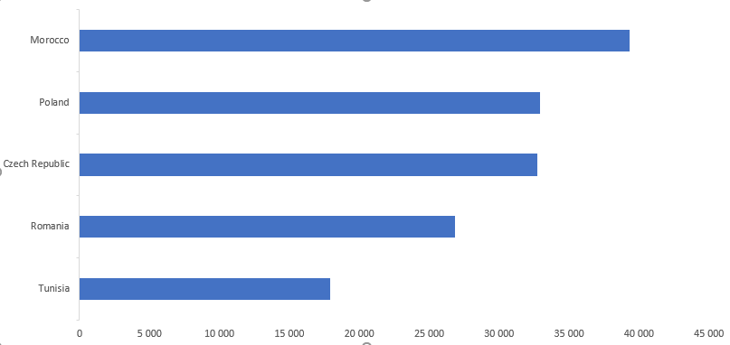
… With Competitive Costs…
  Software Development Engineer (unit costs USD)
  R&D Team Leader (unit costs USD)
Morocco
Czech Republic
Poland
Romania
TUNISIA
Morocco
Czech Republic
Poland
Romania
TUNISIA
  Source : fDi Benchmark 2020

Slide 10

… Positioning TUNISIA in the TOP 3 Rankings
1st
In North Africa for Scientific & Technical Articles – 13th Worldwide (Source : Indice Mondial de l’Innovation 2020)
2nd
In terms of Number of Graduates in Science and Engineering Worldwide (Source : Global Innovation Index, 2020)
3rd
Most innovative Economy in Africa (Source : Global Innovation Index, 2020, WIPO)

Slide 11
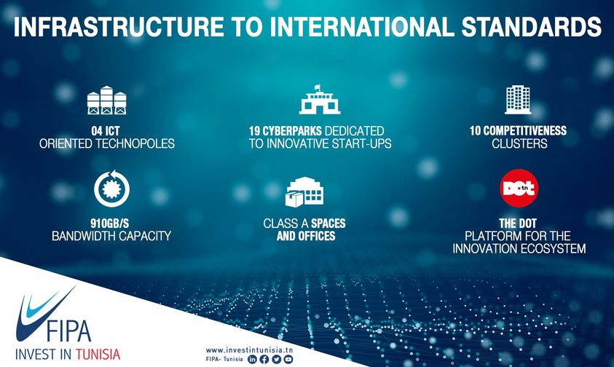
Infrastructure to International Standards
TUNISIA is the 1st country in Africa for the quality of its information and communication technology infrastructure (Source: Bloomberg Innovation Index, 2020)

Slide 12









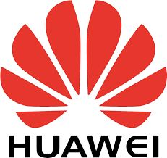

10 competitiveness clusters and 4 IT-oriented technoparks spread over the Tunisian territory and focusing on the promising sectors of the Tunisian economy
19 regional cyber parks support new entrepreneurs during the incubation phase of business projects
One of the largest technology parks in Africa
A surface area of ​​155 hectares
Over 100 national and foreign ICT companies
A surface area of ​​10.5 hectares
A R&D center
An integrated space intended to host activities of:
  academic and research training
  innovation and technology transfer
  production and development
A surface area of ​​60 hectares
Over 65 companies
The technopole brings together 3 laboratories:
  Microelectronic systems
  Advanced materials and nanophysics materials
  Microsystems of physical chemical and biological weapons
Technopoles
Cyber park

Slide 13
A Friendly Business Environment
Investment Law (2016) which guarantees:
Freedom of investment in the majority of sectors
Freedom to transfer profits and capital gains
Simplified procedures of implementation
Intellectual property’s protection
Ease to import and export with simplified customs procedures
With substantial incentives, mainly:
Investment grant for 18 priority sectors and for investment in regional development areas : % of the approved investment cost
Investment grant based on job creation for 18 priority sectors and for investment in regional development areas: Social contribution
Investment grant (1/3 of investment cost) & exemption from corporation tax (10 years) for Projects of National Interest
Reduced corporate tax of 13,5% for wholly exporting regime
Grant for employee training expenditures leading to certification of skills
Hiring foreign managerial staff within a limit of 30% of the total number of managerial staff.

Slide 14
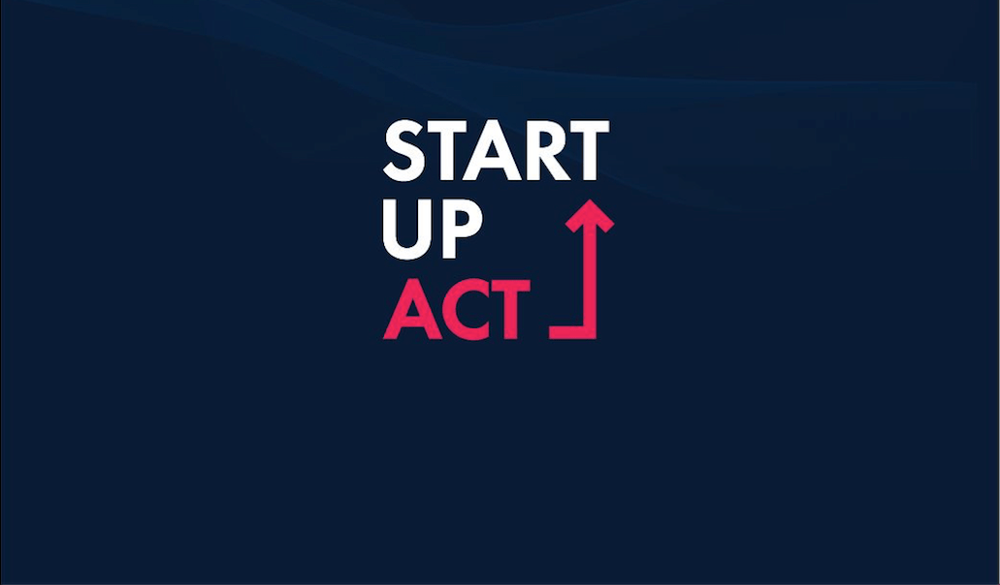

A Friendly Business Environment
A 100 M € Start-up Fund aims to make TUNISIA a Startup-Nation at the crossroads of the southern shore of the Mediterranean, the MENA region and Africa.
30 measures designed to simplify administrative procedures and facilitate access to funding for start-up companies.
Winner of :
The most innovative and high-impact project
Category: Enabling Environment
World Summit on the Information Society Forum (WSIS) – 2020
Ranked :
23rd best worldwide Visa Program to attract Start-ups
1st in North Africa and Middle East
Startups Without Borders (SWIBO) - 2020

Slide 15
SUMMARY
01
FDI Landscape in Tunisia: Key Figures
Major Assets of Tunisia
02
03
Tech sector in Tunisia
04
Invest in Tunisia Agency Missions

Slide 16
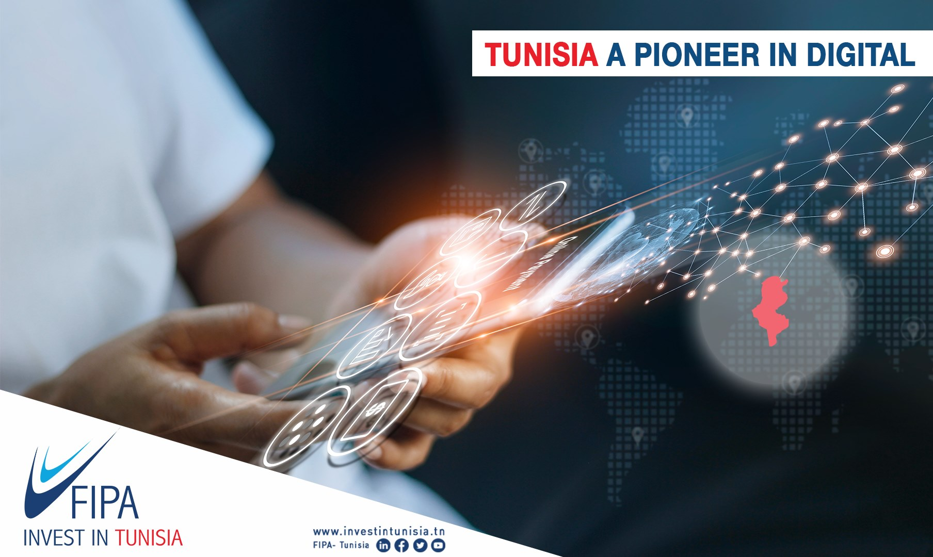
TUNISIA, Confirmed IT Destination
3 Billions € of ICT turnover
7% Average annual growth rate ICT
+ 1800 companies
52% Share of innovative exporting companies
40 000 Direct jobs
Notes:
The IT sector is the new spearhead of the Tunisian economy
The sector has recorded a significant and continuous growth during the last years in terms of turnover, number of companies, jobs …
In Tunisia, innovation is part of most IT companies DNA with more than 500 innovative companies

Slide 17















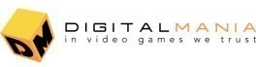




The Tunisian digital industry is fully engaged in emerging technologies
A.I
IoT
AR/VR
Blockchain
Notes:
In a context of rapid innovation and technological progress, the Tunisian digital industry is fully engaged in emerging technologies.
Thanks to a confirmed knowhow, IT companies in Tunisia are able to tackle innovative technology challenges whether it is Artificial intelligence (A.I.), Internet of Things (IoT), Augmented reality/Virtual reality, Blockchain, or Big Data
This rich and diversified ecosystem has also allowed many 100% Tunisian companies and startups to expand internationally and to operate worldwide,

Slide 18
SUMMARY
01
FDI Landscape in Tunisia: Key Figures
Major Assets of Tunisia
02
03
Business Opportunities in Tunisia
04
Invest in Tunisia Agency Missions

Slide 19
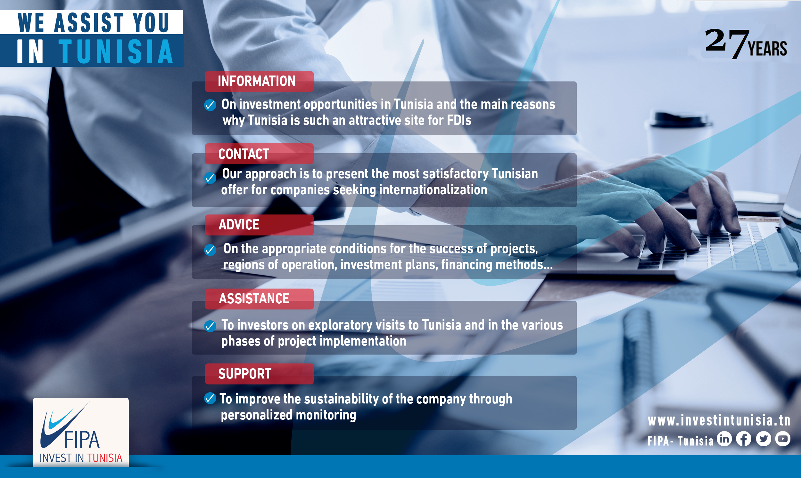

Slide 20


THANK YOU!
FOR YOUR ATTENTION
Email : Abdelbasset.ghanmi@fipa.tn

