Slide 1
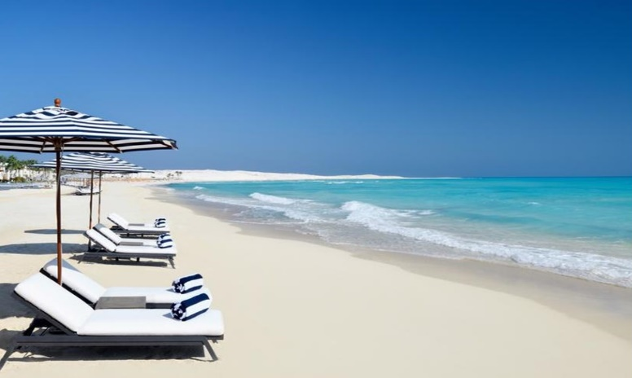


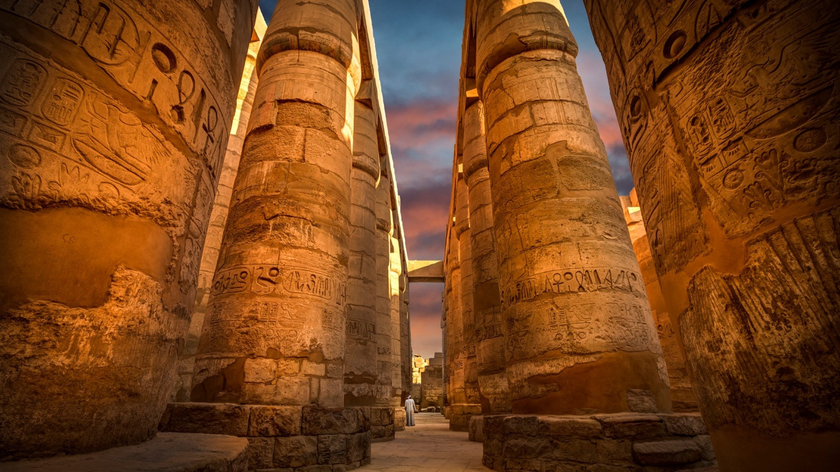

Slide 2



Economic Importance of Tourism to Egypt:
4% (2019)
3.4 Million
Direct & Indirect jobs

Slide 3

International Tourist Arrivals (2016 - 2019):
Unit: Million

Slide 4

Revenues from Tourism (2016 - 2019):
Unit: Billion $

Slide 5
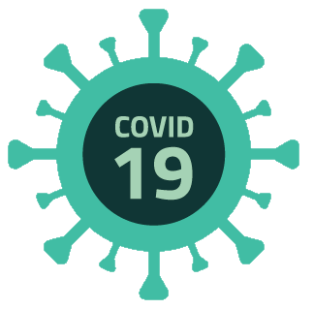

International Tourist Arrivals (January – June 2020):
Unit: thousand

Slide 6
International Tourist Arrivals: July 2020 - May 2021
(Resumption of Travel)

Slide 7

German Tourists Arrivals (2010 - 2019):
Unit: thousand

Slide 8
German Tourists Arrivals (January – March 2020):
Unit: thousand

Slide 9
German Tourists Arrivals (Jul 2020-May 2021):
Unit: thousand

Slide 10



Health Safety Accreditation
Health Safety Certificate
(May 2020):
The currently operating 830 hotel establishments (out of a total of 1207) are certified by the Ministry of Tourism and Antiquities and the Ministry of Health.
Coastal Resorts:
Current workers in resorts located in the Red Sea and South Sinai Governorates are vaccinated.
Vaccination of all residents is to be announced shortly.
June 18, 2020

Slide 11

Travel Precautionary Measures:
Negative PCR test result certificate for COVID-19 (stamped or with QR code) is a must:
72 hours prior to departure time of the direct flight to Egypt.
OR
Upon arrival to Egyptian tourist destinations (at a cost of $30 or their equivalent in other currencies).
Upon departure, PCR testing is available at $30, and Antigen at $20.

Slide 12



Health Safety Regulations for Hospitality Establishments, Archaeological Sites, and Museums

Slide 13
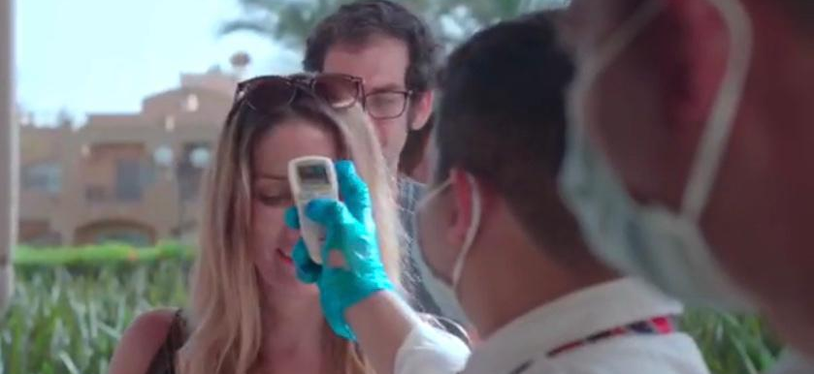
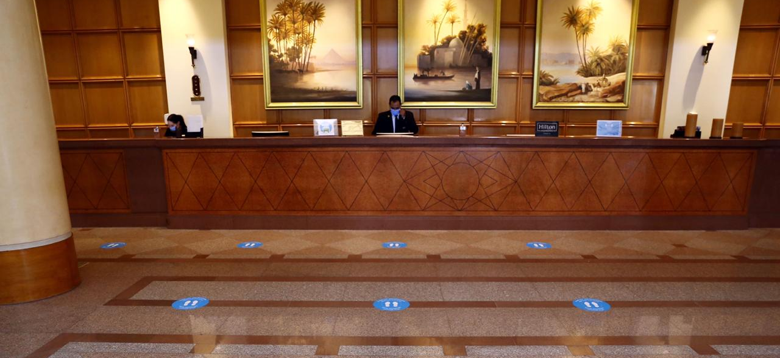
Check-in in Hotels:
Temperatures checks.
Luggage disinfection.
Physical distancing.
Encouragement of electronic payments.

Slide 14
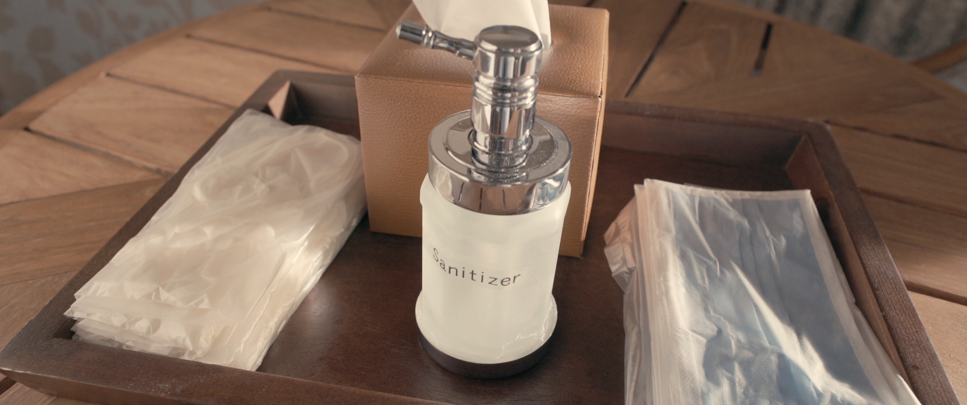
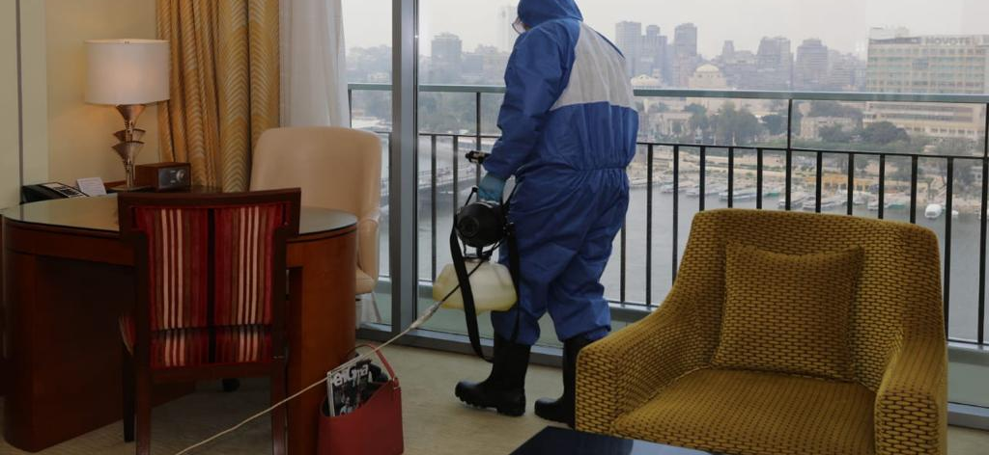
Accommodation:
2 adults + 2 children (under 12 years old) in a room.
Personal Protection Kits.
Disinfection and ventilation of rooms between check-out and new check-in.

Slide 15
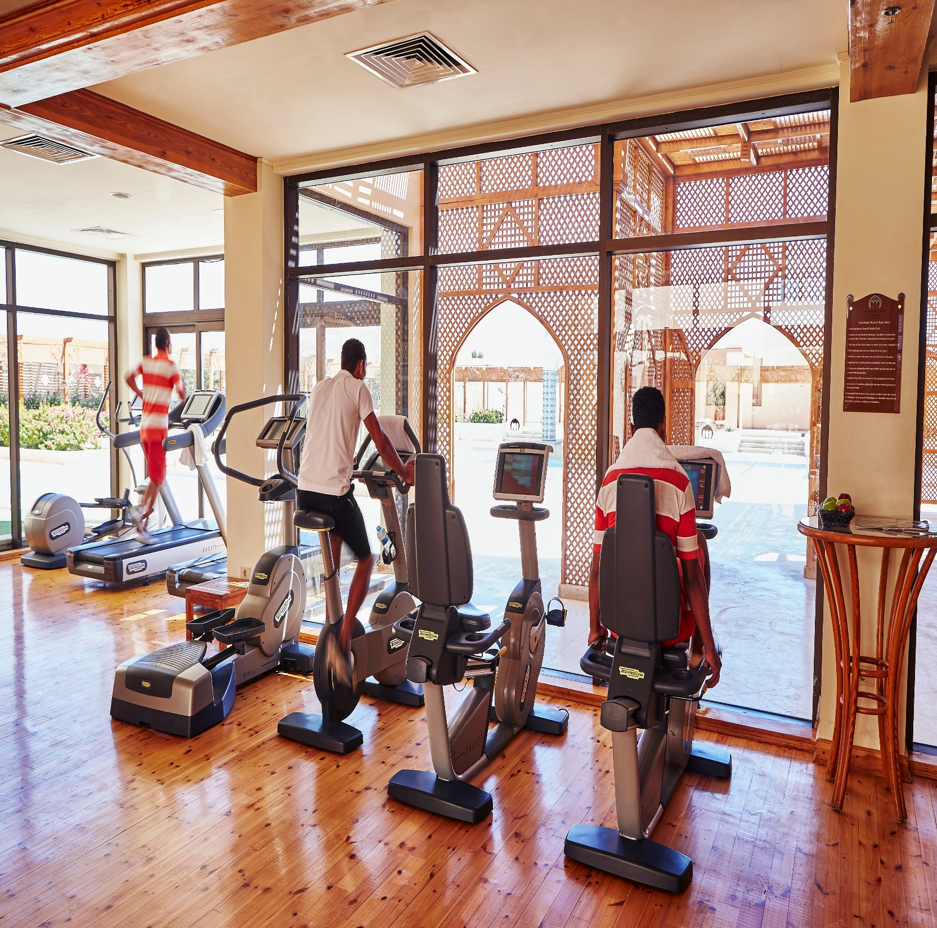
Gym and Health Clubs:
Regular disinfection.
Physical distancing.
No showering.
Use of steam rooms is suspended.

Slide 16
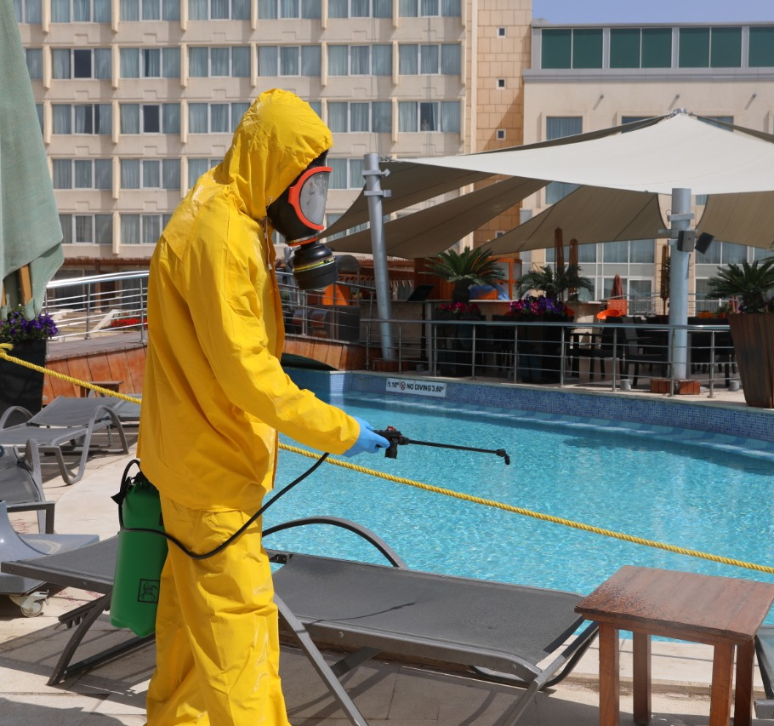
Swimming Pools and Beaches in Hotels:
Regular disinfection.
Placement of sunbeds 2 meters apart.
Delivery of beach and pool towels to rooms.
Reduction of recreational activities.

Slide 17
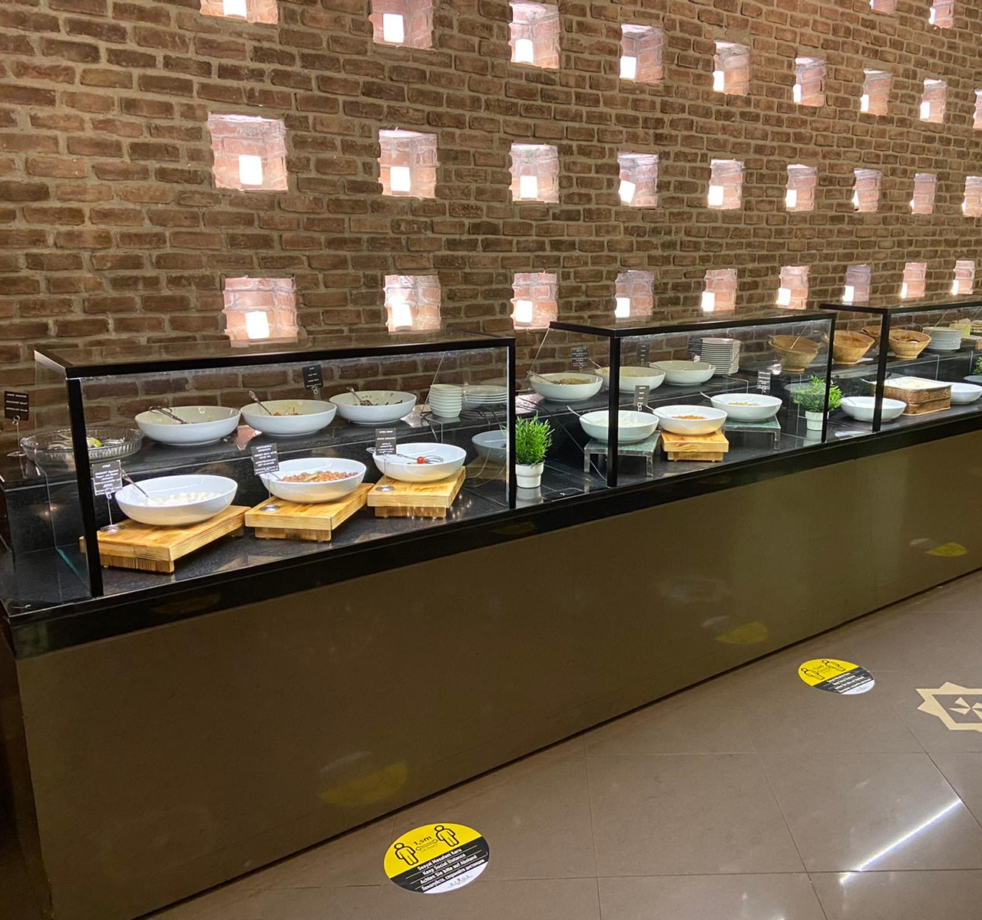
Restaurants:
Temperature checks.
Encouragement of electronic payment.
"Served Buffet” keeping safe physical distancing.
Tables placed 2 meters apart.
Hand sanitizers on tables.
Shisha is prohibited.
Kids areas are closed.

Slide 18
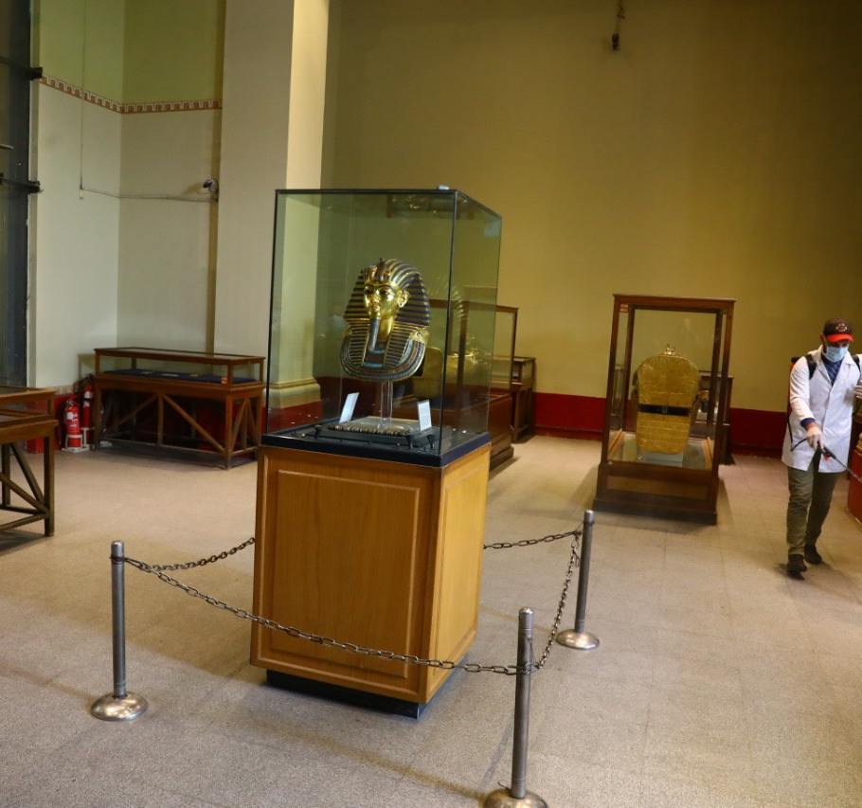
Archaeological Sites and Museums:
Daily disinfections.
Groups are of a maximum of 25 persons.
Guides are required to wear face masks and use audio equipment inside museums.
Provision of face masks to tourists and drivers.
Temperature checks.
Physical distancing.

Slide 19
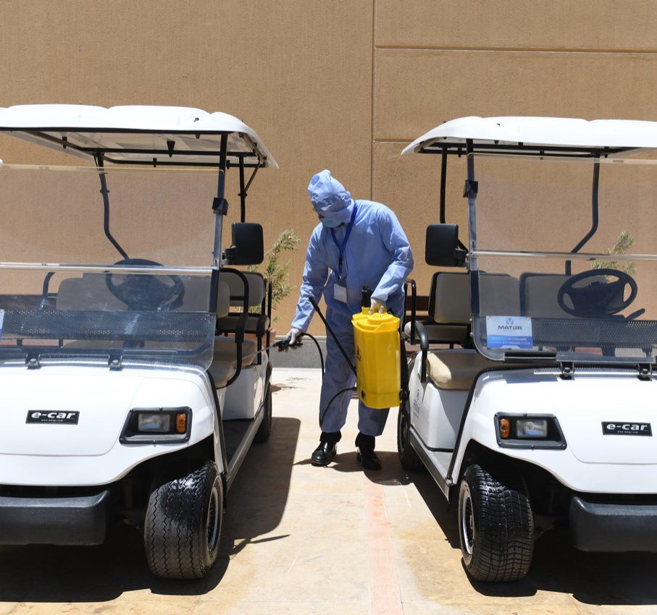
Transportation Vehicles:
Operation with a maximum of 50% capacity.
Passengers are not allowed to sit in the front seats.
Disinfectants and hand sanitizers are provided.
Passengers and drivers are required to wear face masks at all times during the journey.

Slide 20
Tourists Testing Positive for COVID-19 during their Stay:
Hotel notifies the Ministry of Health with any tourist showing symptoms or testing positive.
Designated area in the hotel (or vicinity) for quarantine of minor cases (in case of cruise hotels, quarantine is done in another hotel).
Hotel covers costs of lodging and meals for minor quarantined cases.
Severe COVID-19 cases are hospitalized, and costs of treatment and medication are covered by the Ministry of Health.
Contacts with cases tested positive undergo free medical examination conducted by the Ministry of Health.

Slide 21
Thank you!

