Slide 1
Hybrid-Konferenz
Rechtliche Rahmenbedingungen im
Nahen und Mittleren Osten
Berlin
8. April 2021
13:30 am – 18:00 pm

Slide 2
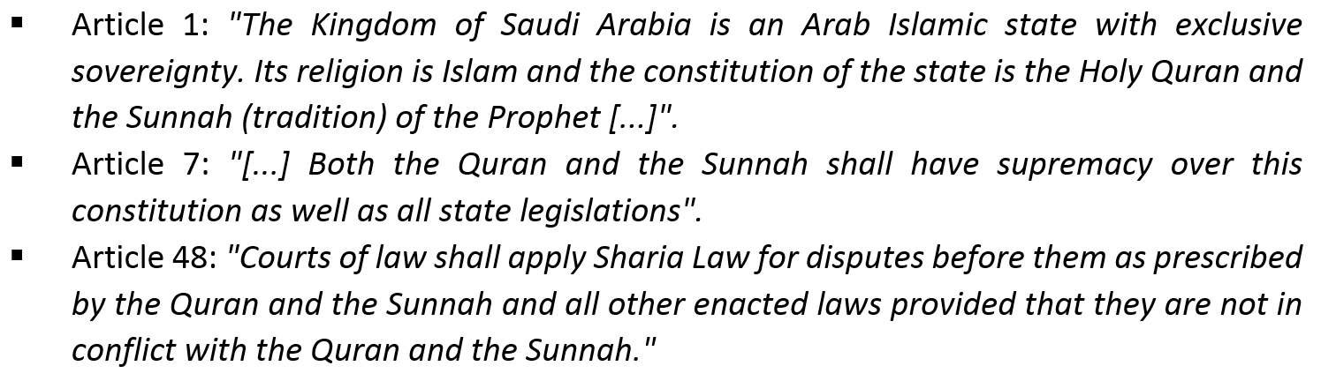
Saudi Arabia: Prevalence of Sharia Law
(Constitution of 1992)

Slide 3

Reform Journey of the Saudi Judiciary
2007
2012
2015
Judicial Reform Program
Civil Procedure Law
Criminal Procedure Law
Judges trained abroad
Arbi-tration Reform
Arbitration Law
Arbitration Center
Mediation
Court Reform
Commercial Courts
Labour Courts
Execution Courts
2021
2020
2019
Codifi-cation, Interna-tional-ization
English common law in NEOM, SEZs
Civil code
Criminal code
Digital Revo-lution
NAJIZ elec-tronic services
Video
Law of Evidence
Com-mercial Procedure Reform
Commercial Court Law
Court Fees Law

Slide 4



59
Rank
137
2009
2019

Slide 5

Hundt & Partners
Kingdom Tower, 10th Floor
Riyadh, KSA
info@hundt-partners.com
www.hundt-partners.com
Jochen Hundt
jochen.hundt@hundt-partners.com
Mob. +966 504 233 752

