Slide 1
Presentation to EBRD - German Near and Middle East
Association (NUMOV) Webinar
05 October 2020
OFFICIAL USE

Slide 2
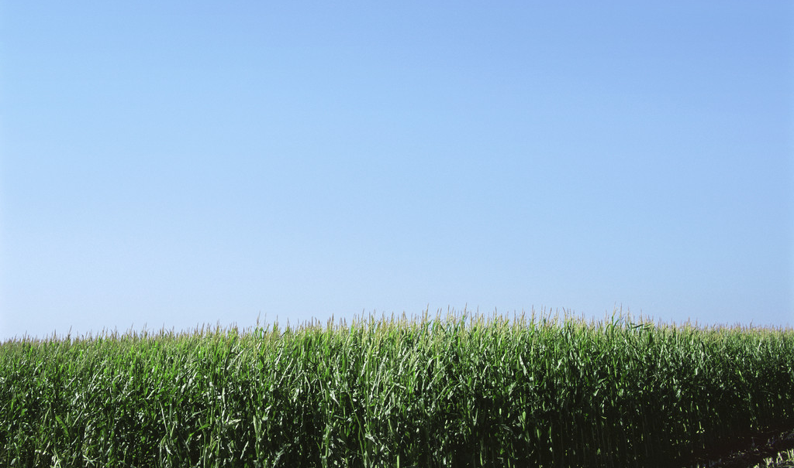
I. Update on EBRD Activity

Slide 3
Largest Investor in its Countries of Operation
  Since 1991, EBRD invested over €142 billion in around 5,670 projects
  EBRD Top 10 investee countries in 2019 (€m)
  In 2019
€10.1 bn
1 | Egypt | 1,214
2 | Ukraine | 1,125
3 | Turkey | 1,002
4 | Poland | 833
5 | Kazakhstan | 685
6 | Greece | 571
7 | Uzbekistan | 517
8 | Serbia | 517
9 | Belarus | 391
10 | Romania | 372
452
projects
Private sector accounted
for share of
74%
Debt: 85%
Equity: 5%
Guarantee: 10%
  EBRD Portfolio (December 2019): € 46.0 billion
  Sector
  Region

Slide 4
EBRD – Financing Instruments Tailored to Project Needs
Loans
Equity
Senior, subordinated, convertible
Long term (up to 10y or more) or short term revolving
Common stock or preferred
Minority position only (up to 35%)
Floating/Fixed rates
Choice of currencies
(€, US$, EGP)
Mezzanine debt
Technical Cooperation
EBRD has a strong track record to mobilize grants from its donors to support
technical assistance to its projects
Other
Guarantees, currency swaps, trade facilitation program etc.
OFFICIAL USE

Slide 5
II. Update on EBRD Agribusiness Activity

Slide 6
Agribusiness at the EBRD
Financing the entire food chain
Crushers (sunflower, soya bean)
Millers
Grain handling
Produce market
Food Service Distribution
Consumers
Grains
Oilseeds
Livestock
Poultry
Dairy
Fish
Horticulture
Produce
Packaging Production
Restaurants
Supermarkets
Institutions
Distributors
Seeds
Fertiliser
Farm machinery
Agricultural inputs
Bio-tech
Distributors
Food Processors
Glass bottles and jars
PET bottles
Cans
Carton containers
Primary Processing
Meat/Fish
Bakery
Snacks
Beverages
Frozen foods
Pet food
Production
Agricultural Inputs
€12.2 billion
invested through 729 projects since 1991
  Active portfolio
  of 220 projects
  or €2.9 billion
  €740million average annual business in the past 3 years
  invested through
  161 projects

Slide 7
2019 Agribusiness Investments
2019 Annual Business Investments
Active portfolio composition
Central
Europe & Baltics
11%
Central
Asia
11%
Eastern Europe
& Caucasus
33%
South-eastern
Europe
13%
SEMED*
6%
Turkey
26%
Note: South-East Mediterranean (SEMED): Egypt, Jordan, Lebanon, Morocco, Tunisia, West Bank/Gaza
Note: Food manufacturing includes packaging manufacturing
Note: Debt includes Guarantees portfolio (4%)

Slide 8


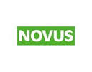




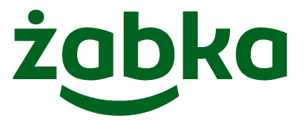











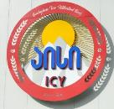



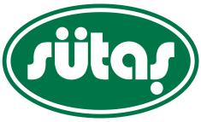





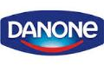
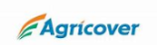




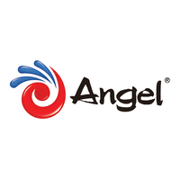
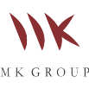


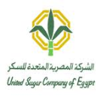









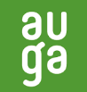
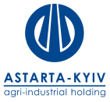




EBRD agribusiness clients and partners

Slide 9
III. Green Investments at the EBRD

Slide 10
Green investments with EBRD
The Green Economy Transition (GET) approach is EBRD’s strategy towards building a low carbon and resilient economy.
Working with the private sector, municipalities and public institutions, the GET business model entails the combination of green investments, concessional financing, policy engagement and technical support.
To date, the EBRD has signed €34 billion in green investments and financed over 1,900 green projects, expected to reduce 102 million tonnes of CO2 emissions per year.
A stronger focus on sustainable loans will result from the Bank’s new Green Economy Transition Plan (GET 2.1). Under it, the EBRD targets to make 50% of its financing green by 2025.
  GET Targets 2016 - 2020:
  New GET 2021 - 2025:
  40%
  Target Share of Green Investments in Total
  Currently 30%
  €4 bn
  Target Annual Green investments
  50%
  Target Share of Green Investments in Total
  25 - 40
  million tonnes
  Of greenhouse gas emissions reductions
  €18 bn
  Target Cumulative Green Investments
  Alignment
  Of all EBRD Projects with the Paris Agreement

Slide 11
Green investments with EBRD (cont’d)
Funding through green financial instruments follows a double rationale: it underpins our the clients’ sustainability agenda while supporting the Bank’s mandate.
Benefits for the client are wide and diverse:
  Enhanced ambition levels in terms of ESG performance.
  Positive impact on visibility, reputation and credibility.
  Financial incentives linked to the successful implementation of sustainability strategies.
  Strengthened long-term growth and profitability, as a result of lower ESG risks and operational savings (energy, waste, water).
There are 2 main available instruments in the market: Green Loans (GLs) and Sustainability Linked Loans (SLLs).
GLs targets the earmarking of proceeds for eligible green projects, while SLLs link a financial incentive with the achievement of measurable sustainability targets.
Interest reduction is possible under SLLs, which in turns results in a double benefit: monetary savings and higher ESG realized standards.
EBRD could involve donor financing for activities such as external results verification, auditing, ESG and/or environmental consultancies, and others.

Slide 12
Main areas of focus for green investments in agribusiness
Resource Efficiency
Bio-economy
Circular Economy
Climate Resilience
Carbon neutrality
Sustainable Corporate Governance/ TCFD
Sustainable Food
Sustainable/Smart Farming
Sustainable Logistics
Land Degradation
Natural Capital
Paris Alignment

Slide 13
IV. Agribusiness Investments in Southern & Eastern Mediterranean (SEMED)

Slide 14
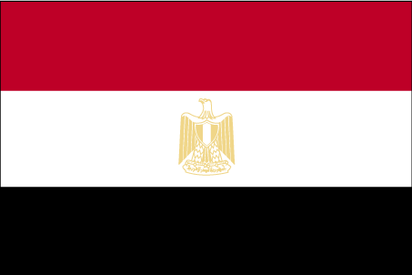
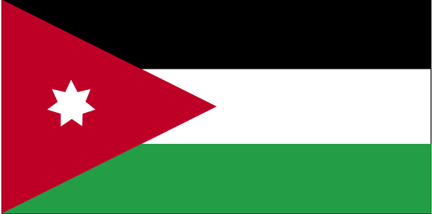
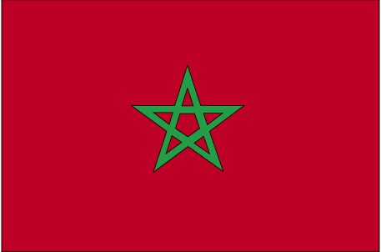

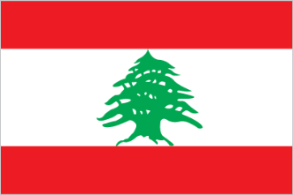
EBRD Expansion to the Southern and Eastern Mediterranean (SEMED)
The Board of the EBRD decided in 2011 to expand the Bank’s operations to Egypt, Jordan, Morocco, and Tunisia. In 2017, Lebanon and the West Bank became countries of operation.
To date the Bank invested in ca. 212 projects in the SEMED region for a total amount of ca. EUR 9 billion (70% in the Private Sector).
In the Agribusiness sector, the Bank signed to date 30 projects in SEMED for a total of ca. EUR 600m
The Bank opened resident offices in each of Casablanca, Tunis, Cairo, Beirut, and Amman.
Agribusiness priorities in the SEMED region include:
    Support investment along the food chain to strengthen linkages and increase standards;
    Support consolidation in agriculture and processing to take advantage of economies of scale and facilitate modernisation;
    Focus on crops where these countries have a competitive edge for export activity (e.g. olive oil);
    Supporting foreign direct investments in the private sector;
    Promoting sustainable energy and resource efficiency investments;
    Support development of modern retail and appropriate logistical infrastructure across agribusiness value chain.

Slide 15
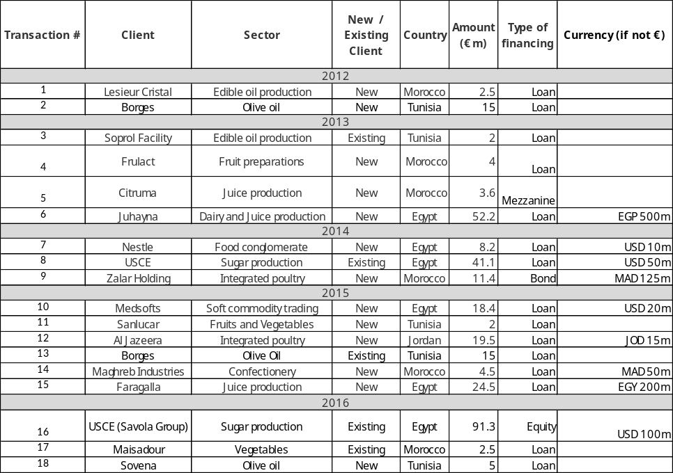
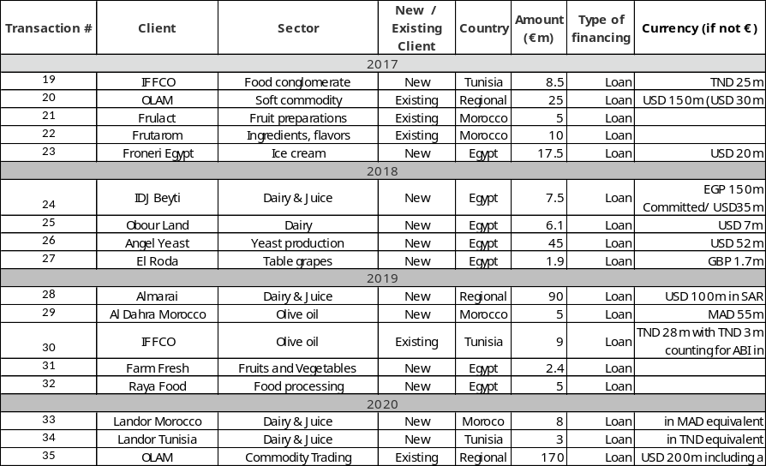
Agribusiness Investments in SEMED – Snapshot
Total of 35 transactions since 2012 for a total exceeding EUR 600m

Slide 16
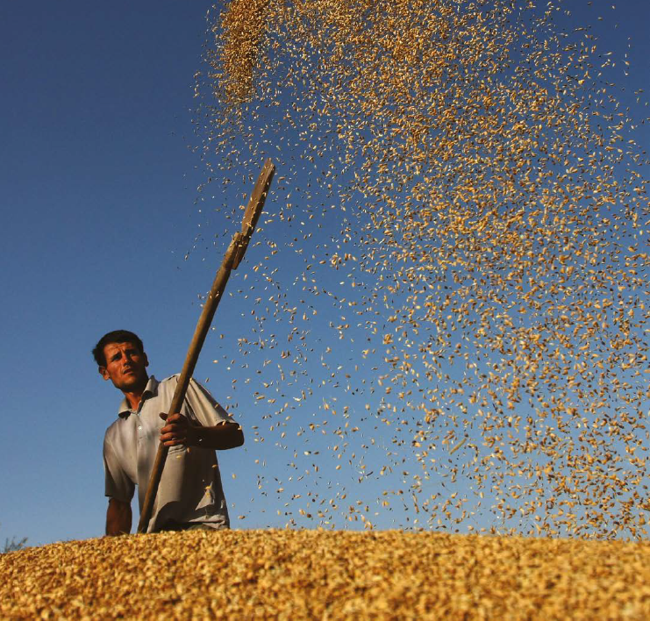
Advisory and Policy Dialogue in SEMED – Addressing grain supply inefficiencies in Egypt
  The EBRD, together with the Food and Agriculture Organization of the United Nations (FAO), is facilitating dialogue between private sector grain importers and Egyptian public authorities to address wheat supply chain inefficiencies by supporting:
  The establishment and activities of the Egyptian Grain Suppliers Association, which represents the industry’s voice in discussion with the government;
  Efforts to bring Egyptian grain import rules in line with international best practice and training public-private stakeholders on grain testing and phytosanitary treatment;
  Improvements in the policy and investment environment through enhanced trade logistics and information transparency.

Slide 17
Advisory and Policy Dialogue in SEMED –Improving Quality Standards in the Moroccan and Tunisian Olive Oil Sectors
  The EBRD, together with FAO, is working with public-private stakeholders in Tunisia and Morocco’s olive oil sectors to support:
Sector review to assess the efficiency of the countries’ olive and olive oil production and identify investment needs;
Public-private working groups set up to lead dialogue with the government and address key issues in the sector;
Trainings of over 600 farmers on best practice in farming, pruning and water management;
Knowledge exchange and sharing best practice between inter-professional organisations from Spain and Italy and local producers/associations;
Providing technical assistance and expertise to support product quality certification, traceability and labelling schemes.

Slide 18
V. Selected Agribusiness Investments in SEMED

Slide 19
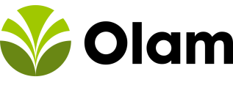
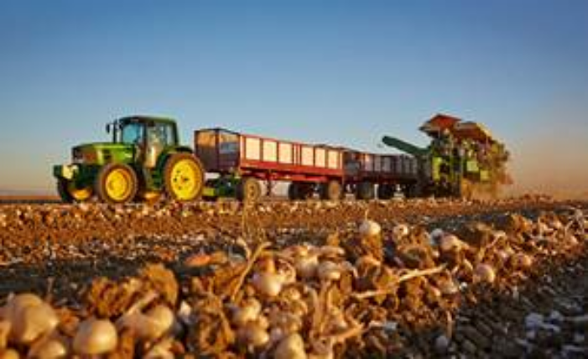
Regional – Olam – Working Capital Financing
One of the largest integrated agri-commodity traders/processors in the world, active in bulk agri-commodity trading, agri-raw materials (such as coffee, cocoa, nuts and spices) as well as industrial materials such as cotton, wool and timber
The EBRD provided US $150m in long term working capital loan for Olam’s operations in Egypt, Turkey, Ukraine, Poland, and Georgia, to finance purchase, processing, storage and transportation of agricultural commodities in the project countries: mainly hazelnuts in Turkey and Georgia, dry dairy products and grain in Ukraine, onions in Egypt and dry dairy products in Poland.
The EBRD signed a new USD 200m loan with Olam in 2020. As part of this project, a significant number of farmers will be added to Olam’s supply chain, improving the quality of products and operational standards. The project will also support Olam in developing new tools for climate-related risk management and climate scenario stress-testing, in order to build effective climate corporate governance along its value chains (starting with the pilot value chains of hazelnut in Turkey and onion in Egypt). Climate corporate governance is a fairly novel area, especially outside the financial sector, and the EBRD is at the forefront of this movement by engaging actively with non-financial clients on this topic to improve their resilience to climate change.
2017-20

Slide 20

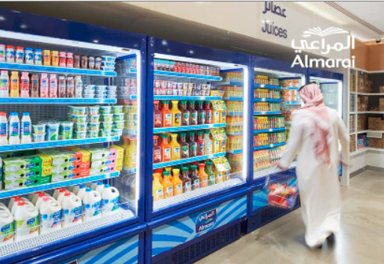
Al Marai – Egypt and Jordan – Financing the expansion of a large dairy and juice producer in Egypt and Jordan
Almarai is one of the largest vertically integrated dairy companies in the world and one of the largest food conglomerates in the MENA region, with operating assets across the GCC, Egypt, Jordan, and the United States and Argentina (where Almarai operates arable farms)
The EBRD provided a loan of up to USD 100m (in SAR). The Loan is on lent to the Egyptian and Jordanian subsidiaries, Beyti and Teeba respectively. Both subsidiaries are 52% owned by Almarai and 48% owned by PepsiCo.
The investment will support market expansion of the dairy and juice sectors in Egypt and Jordan by strengthening backward and forward linkages.
Moreover, a dairy sector diagnostic will be done in Jordan.
2019

Slide 21
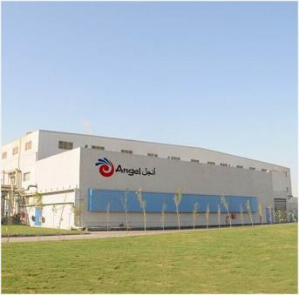
Egypt – Angel Yeast – Supporting a Major Chinese Investment in Egypt’s Yeast Sector
Angel Yeast Egypt is a subsidiary of Angel Yeast China, a global manufacturer of yeast and yeast extract, listed on the Shanghai Stock Exchange.
The EBRD provided a long-term loan of $52m to finance the construction of state-of-the art yeast extract production and new water treatment facilities. The loan will also enable the company to increase production of dry yeast, which is mainly exported, and to launch a yeast extract, a higher value-added product.
The project marks the first EBRD cooperation with a Chinese company in the corporate sector. The investment will support foreign direct investment, boost export sales and create jobs in Egypt’s agribusiness sector.
2018
21

Slide 22
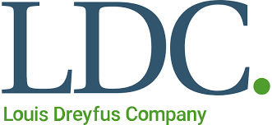
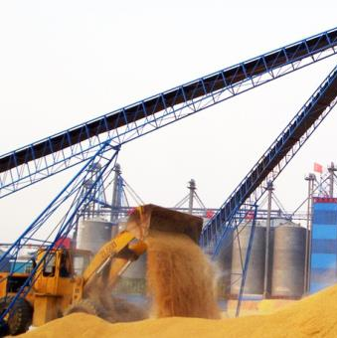
Regional – Louis Dreyfus Commodities – Strategic Support through Debt & Equity
Louis Dreyfus Commodities is one of the world’s largest commodities trader and processor of agricultural goods.
The EBRD supported LDC for over 11 years in several countries:
    US $100m 3-year revolving credit facility to finance working capital mainly in Ukraine, Egypt, Bulgaria, Romania, Kazakhstan, and few other countries (being a replacement of previous US $75m facilities in Ukraine and Russia in 2009, renewed in 2013, and augmented to Kazakhstan in 2014)
    US $40.8m equity investment for the acquisition of new silos and the modernisation of the existing silo network in Russia and Ukraine (first tranche in 2006, and subsequent tranche in 2016)
2006-17
22

Slide 23
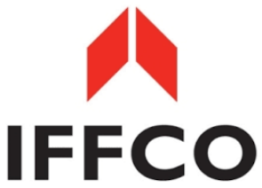
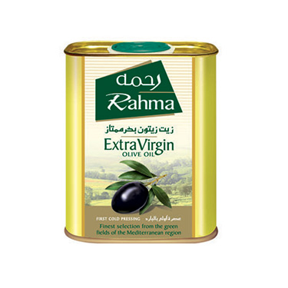
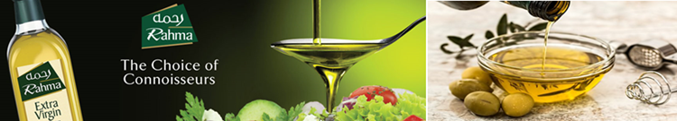
Tunisia – IFFCO – Supporting a Strategic Player in the Tunisian Olive Oil Sector – Working Capital Loan
    COGIA
    COGIA is the Tunisian subsidiary of Allana International Limited (AIL), the top holding of the IFFCO group of companies based in the Gulf region, Tunisia and Mauritius. COGIA is one of the few leading olive oil companies in Tunisia mainly focused on exporting Tunisian bottled olive oil.
    IFFCO Group is involved in multiple agribusiness activities, including, but not limited to, the manufacturing and distribution of edible oils and fats, snacking products, processed meat, poultry products, juice drinks, ice cream, and packaging.
    EBRD Financing
    A TND 25 m revolving working capital loan to support COGIA’s growing olive oil sourcing, bottling, and exporting of bottled Tunisian olive oil.
2017

Slide 24
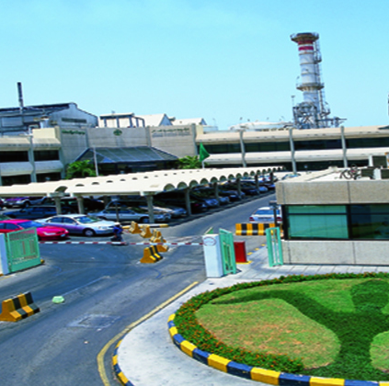
Egypt – Savola Group– Supporting Long Term Working Capital Needs through Equity Investment
  United Sugar Company is a sugar refinery in Egypt (“USCE”), whose major shareholder is Savola Group Company, one of the largest and fastest growing multinational food groups in the MENA region with a diversified business portfolio, including edible oils, sugar, pasta, retail and plastics.
  The EBRD invested US $100m equity through a capital increase to acquire a 46.3% stake in the company.
  The project will:
    Strengthen USCE’s balance sheet and support its working capital needs in expanding both exports and local sales
    Allow deconsolidation of USCE from Savola Group Company (listed Saudi company)
    Develop re-certification of the management systems to ISO 14001 and OHSAS 18001 standards
    Facilitate implementation of new technology to ensure reduced NOx emissions
2016

Slide 25

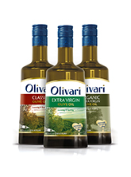

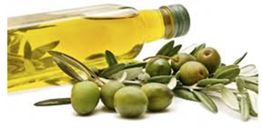
Tunisia – Sovena – Working Capital Financing
    Borges
    Sovena MENA and Tiba Foods are Tunisian subsidiaries of Sovena Group, the leading Portuguese producer and distributor of olive oil and oilseeds oils, olives and soaps, with facilities in 7 countries and exports to over 70 countries in Europe, Africa and the Americas.
    The Group is the world’s largest private label supplier of olive oil and is increasingly developing its own brands (e.g. Olivari, Fontoliva etc).
    EBRD Financing
    A EUR 5m working capital loan to expand Sovena’s olive oil sourcing operations in Tunisia and further strengthen their relationship with their partner suppliers. It will also support the increase of Sovena’s olive oil bottling operations in Tunisia.
2016

Slide 26
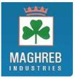
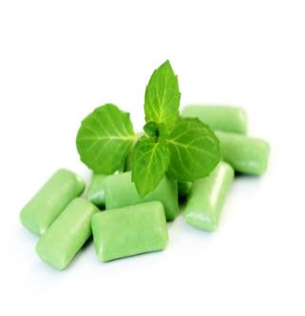
Morocco – Maghreb Industries – Financing the First Private Sector Sponsored PV Project
Maghreb Industries, a locally-owned SME and leading chewing gum and confectionery producer in Morocco.
The EBRD provided a EUR 4.6 million loan (in MAD equivalent)
The transaction will support:
  construction and operation of a modern, energy efficient facility in Casablanca powered by a 1.4 Megawatt rooftop solar plant, one of the first of this size in Morocco;
  Around one third of energy used in future will be renewable, leading to a significant demonstration effect.
  The project benefited from Technical Cooperation funds made available under the Advice for Agribusiness programme support through two international industry experts, the Small Business Initiative, and Energy Efficiency team support.
  The Project also won in 2016 the EBRD Sustainability Award in the “Environmental and Social Innovation” category.
2015

Slide 27
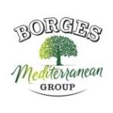
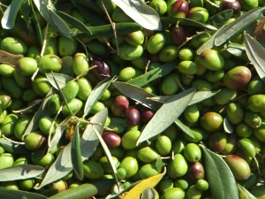
Tunisia – Borges – Working Capital Financing
    Borges
    Borges, a privately held company, is headquartered in Lleida, Spain, and is one of the world leaders in packaged dried fruits and nuts, and the largest Spanish exporter of bottled olive oil.
    EBRD Financing
    A EUR 15 m 3 year working capital loan to fund the expansion of Borges olive oil operations in Tunisia targeting export markets.
    Technical Cooperation
    The TC focused on providing expertise in quality control – particularly in the area of safety and hygiene in olive oil production and related operations – to Borges Tunisia personnel, its key suppliers, and the farmers who supply olives to these key suppliers.
2015

Slide 28

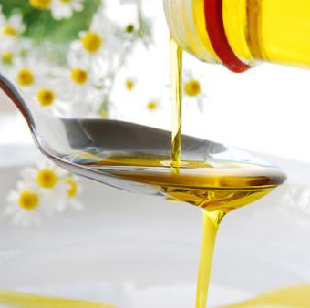
Morocco - Lesieur Cristal – Financing Innovative Energy Efficiency Project
    Lesieur Cristal
    Lesieur Cristal, leading edible oil and soap producer in Morocco, is a subsidiary of French Groupe Avril.
    EBRD Financing
    Long term loan of EUR 2.5m.
    Use of Proceeds
    Lesieur Cristal used the funds to finance the construction and commissioning of a new biomass boiler using olive waste (« grignons ») as feedstock.
    This investment allowed the company to reduce its fuel consumption by at least 30%.
2012

