Slide 1
Renewable Energy: opportunities and projects in SEMED
Gabriel de Lastours, Regional Head, Energy SEMED
NUMOV, 5 October 2020
PUBLIC
Notes:
Last updated in 16 September 2014.

Slide 2
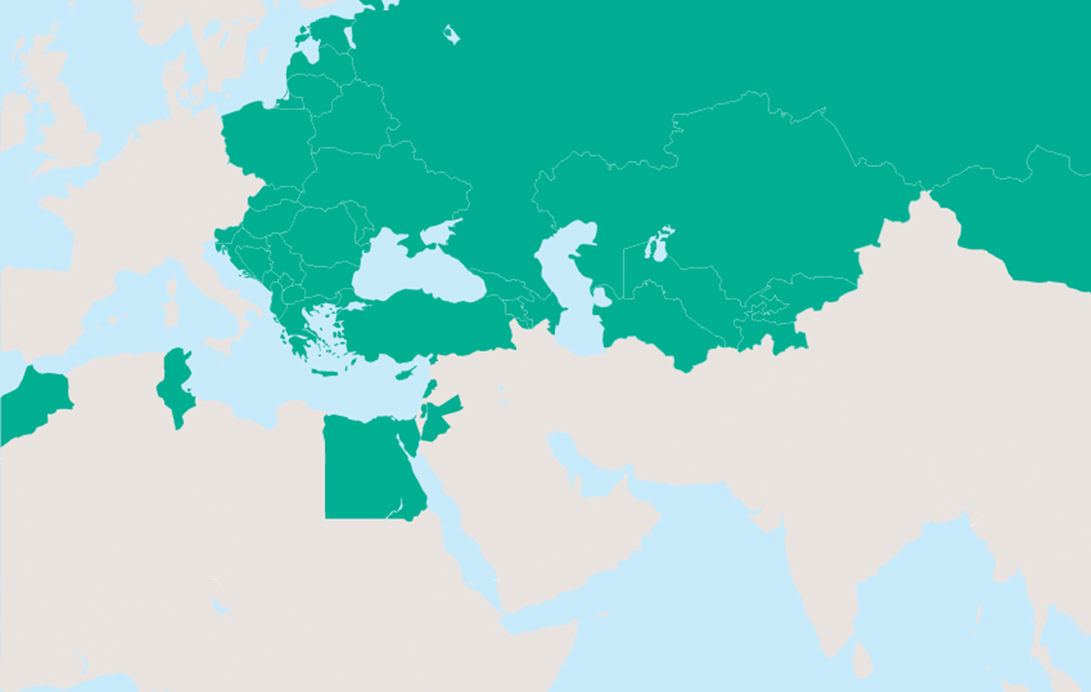

Renewable Energy is at the center of what we do
Poland
1,331 MW wind
130 MW biomass
Estonia
193 MW wind
20 MW biomass
Russian Federation
40 MW geothermal
Belarus
11 MW biogas
Ukraine
426 MW solar
223 MW wind
18 MW biomass
4 MW biogas
3 MW hydro
Romania
557 MW wind
50 MW solar
Serbia
263 MW wind
26 MW hydro
4 MW biogas
Kazakhstan
572 MW solar
Hungary
158 MW wind
Georgia
414 MW hydro
21 MW wind
Croatia
1.5 MW biomass
North Macedonia
27 MW hydro
12 MW solar
Montenegro
72 MW wind
4 MW hydro
Mongolia
155 MW wind
30 MW solar
Bulgaria
216 MW wind
26 MW hydro
Albania
32 MW hydro
Kosovo
137 MW wind
Azerbaijan
113 MW hydro
Greece
189 MW wind
30 MW various
Armenia
22 MW hydro
Turkey
520 MW wind
287 MW geothermal
103 MW solar
24 MW hydro
186 projects in >30 countries
9.0 GW of new renewable capacity financed
EUR >5.5bn of EBRD investment in renewables
Equivalent total project value of EUR >18.5bn
  Map only shows greenfield capacity. MW total is greater than shown on map due to regional projects not included and other minor adjustments.
Renewable projects from 1991 to Jan 2020
Morocco
120 MW wind
Jordan
360 MW solar
127 MW wind
Cyprus
12 MW solar
Egypt
967 MW solar
252 MW wind
European Bank for Reconstruction and Development | Sustainable Infrastructure Group
5 October, 2020
5 October, 2020
2
05/10/2020
2

Slide 3
We are involved in every step of developing renewables
Investment
Technical cooperation
Policy dialogue
Promoting sustainable energy
Honest broker role
Sharing experience and best practice
Development equity
Mezzanine
Project finance
Corporate loan
Equity
Regulatory frameworks
Tender support
PPA drafting
Grid absorption studies
5 October, 2020
PUBLIC

Slide 4





In SEMED we combine policy dialogue and financing
Support to develop bankable PPAs has opened the private RE market
2013-2015
2016
2017
2018
2019-2021
Support for PPA
FiT Round 1: Solar - Ma’an, Scatec (Oryx, EJRE, Greenland). Wind - Shobak, Al Rajef
Round 2: Solar - ACWA, FRV Hareon, FRV Safawi. Risha
Wheeling – Kawar/ Orange, Yellow Door
Support for MV integration in 13-09 law framework
Grid code for renewables integration / Renewable Energy modelisation within VHV, HV and MV networks
Khalladi: First fully private
Further 13-09 framework Projects expected
Support for PPA
Grid code for solar / Benban and East Nile SESA
Support for tenders
Lekela wind farm
Kom Ombo
Support for Authorisation Regime PPA
Support for Concession Regime PPA
First RE projects
Support for PPA
First RE projects

Slide 5
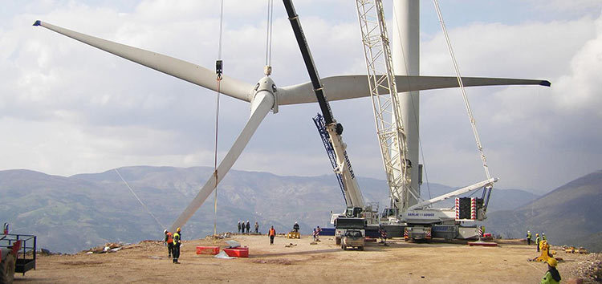
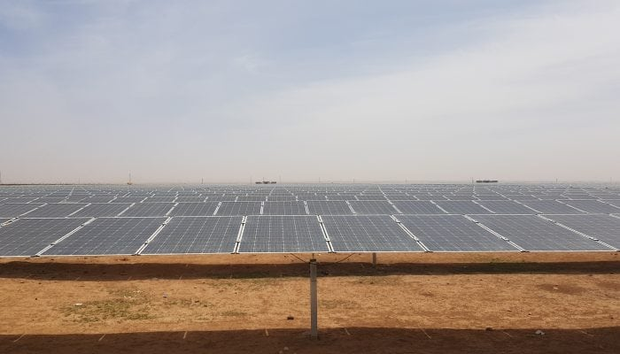
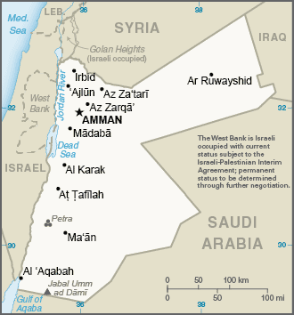
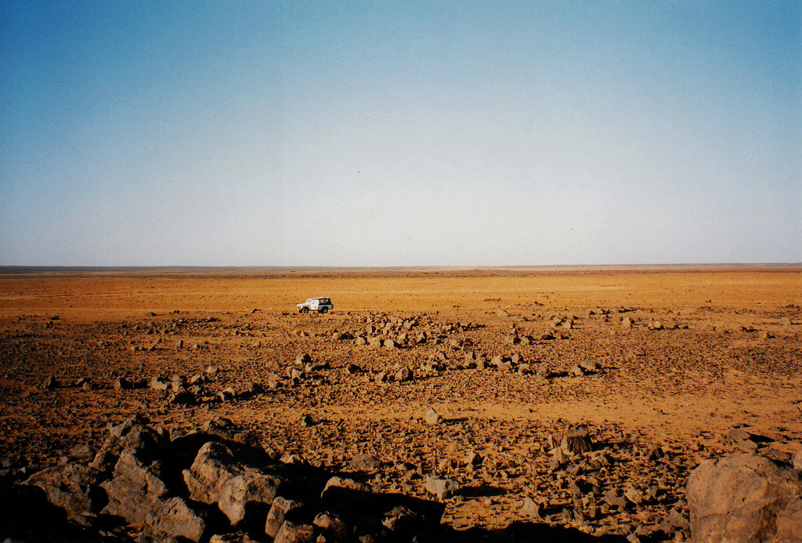
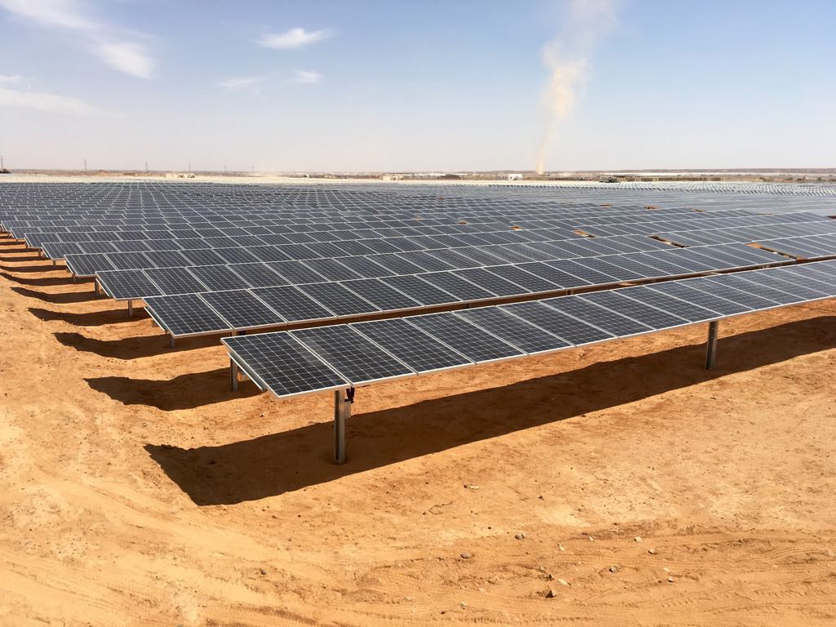
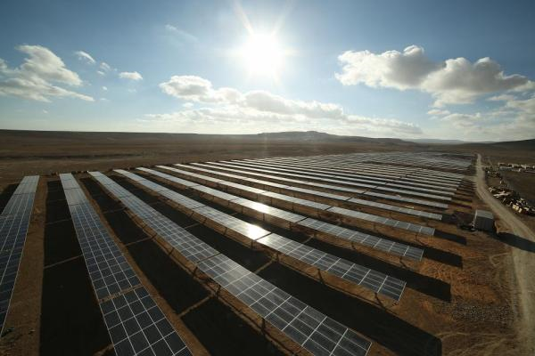
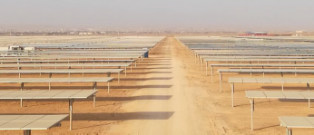
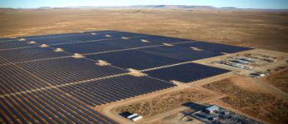
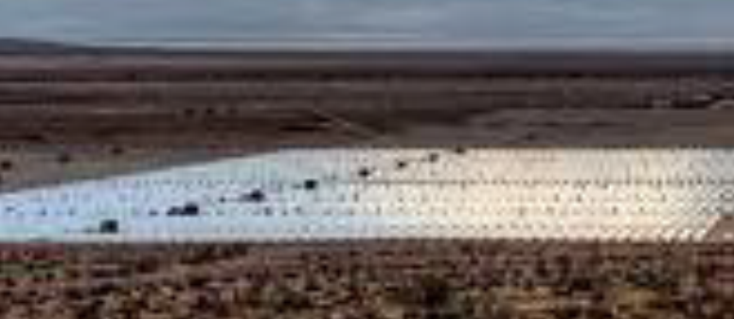
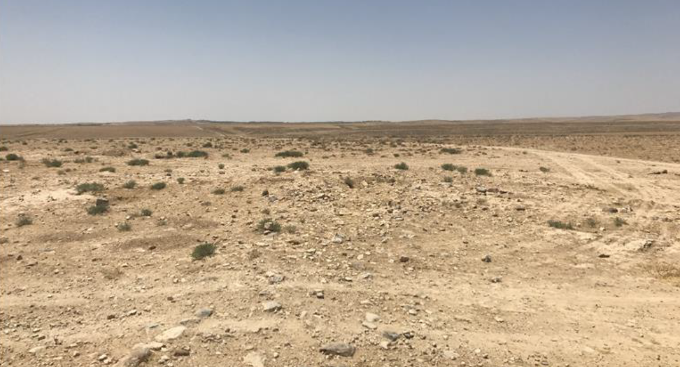
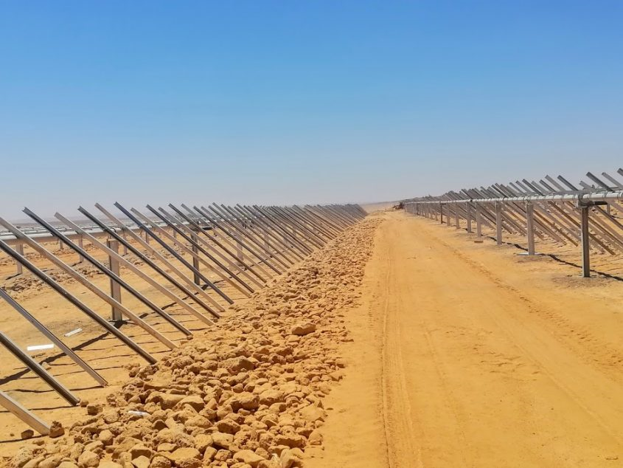
EBRD supported the growth of renewables in Jordan
EBRD financed two successive rounds of solar and wind projects, 10 in total
Al Rajef Wind Farm
Wind Farm (82MW)
Alcazar Energy
FRV Mafraq Solar Project Solar Park (50MW)
FRV
Risha Solar Project
Solar Park (50MW)
ACWA Power
Ma'an Solar Project
Solar Park (24MW)
Alcazar Energy
Oryx Solar Project
Solar Park (10MW)
Scatec Solar
ACWA Power Mafraq PV
Solar Park (50MW)
ACWA Power
EJRE Solar Project
Solar Park (20MW)
Scatec Solar
Greenland Solar Project Solar Park (10MW)
Scatec Solar
Shobak Wind Farm
Wind Farm (45MW)
Alcazar Energy
Al Safawi Solar Project Solar Park (51MW)
FRV
5
PUBLIC

Slide 6















Case Study 1: the Egypt Feed-in-Tariff programme (2015-2017)
EBRD developed an ambitious and comprehensive policy dialogue effort from 2015…
2015
2016
2017
PPA Support with local authorities
Grid code for solar power integration / Strategic ESIA in Benban and East Nile
FiT 2nd Round Financing
… which lead to the financing of the largest solar complex in Africa.
986 MWp
Across 16 Projects
USD 1,130 million
Total Projects Cost
USD 368 million
EBRD Debt Investment
USD 476 million
Mobilised Co-Financing
Co-Lenders
Sponsors

Slide 7
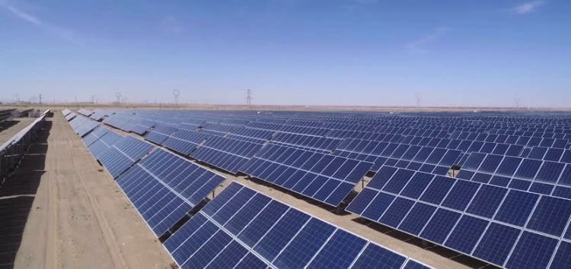
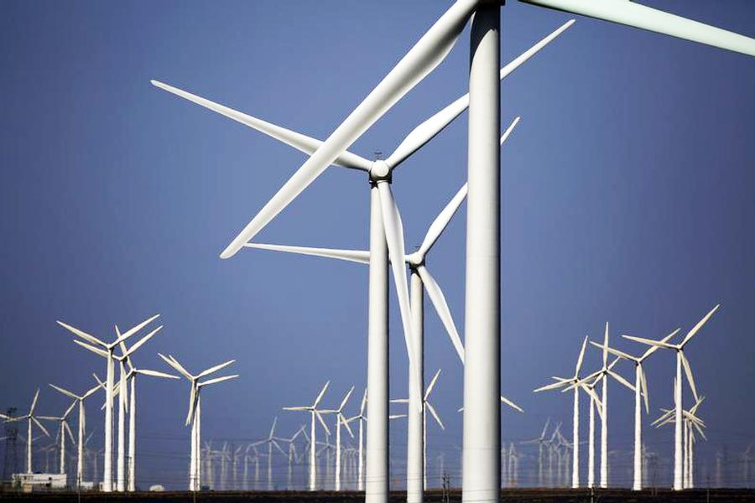
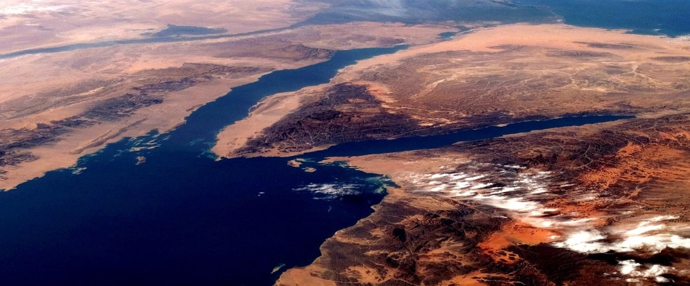
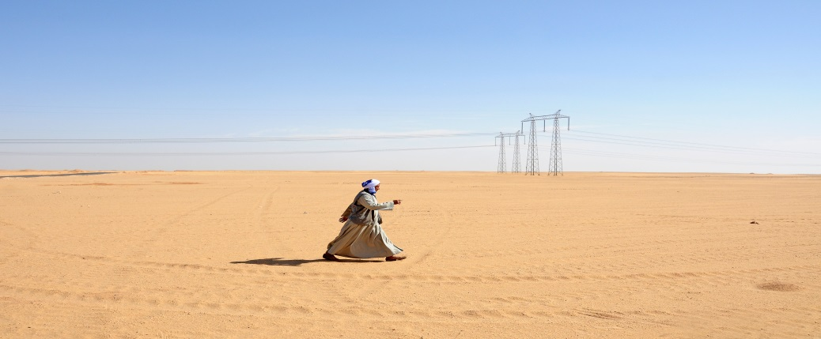
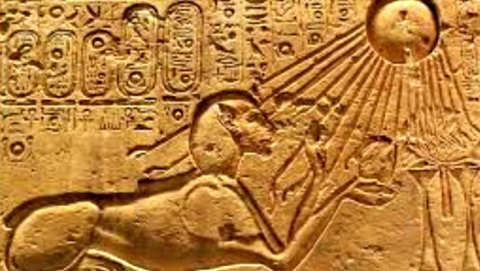
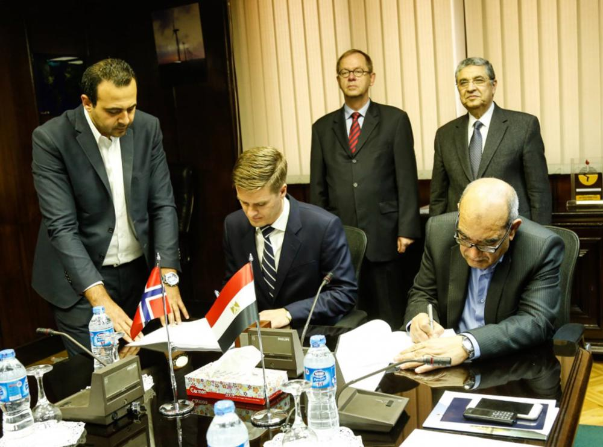
Case Study 1:
Success Factors
Outstanding Resources
Egypt has one of the best solar resources in the world, which allowed the Benban projects to obtain a yield of 3000kWh/m2/year
Competitive Tariff
The Round 2 FiT minimised retroactive change risk as it was competitive with short-run cost of gas power plants
.
Indexed Tariff
The FiT is paid in local currency, but is 70% indexed to USD, hence minimising the foreign exchange risk of the projects
Take-or-Pay Framework
The projects’ electricity generation offtake is structured as take-or-pay thus protecting the projects against volume risk and curtailment
Stable Environment
The political situation in Egypt has improved since 2011 resulting in a gradual return to political stability, thanks among other to strong IMF support
Engagement
The programme was able to attract strong international, regional and local sponsors, relentlessly working for the successful implementation of the programme

Slide 8


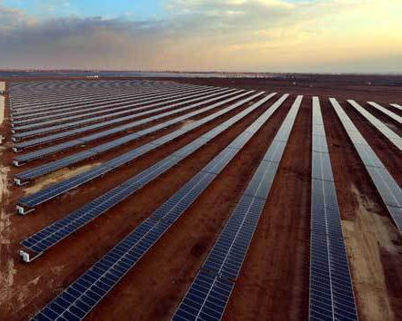
Case Study 2:
Kawar/Orange (Jordan, 2019)
First project finance for solar PV plant developed under Jordan's wheeling scheme
  Key Facts
  Sponsor: Kawar Investment
  Offtaker: Orange Telecom Jordan
  Project: 37MWp solar plants over 3 sites
  Project Cost: USD 46 million
  EBRD Finance: USD 15 million
  Climate financing: USD 5 million
  Co-Lender: Jordan Kuwait Bank and CAB USD 15 million
  Structure: Senior secured non-recourse project finance structure. Loan in local currency (MAD)

Slide 9



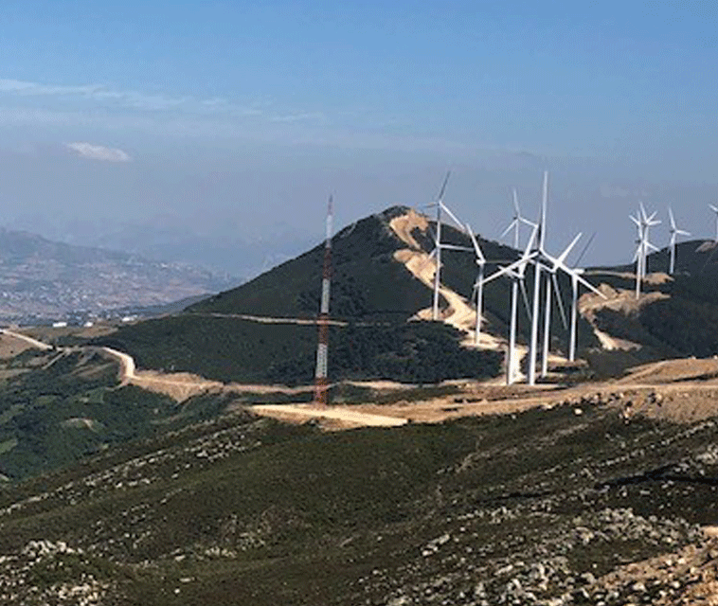



Case Study 3:
Khalladi wind farm (Morocco, 2016)
First private project to sell electricity directly to private offtakers under a long term PPA
  Key Facts
  Offtakers: three Moroccan cement companies
  Project: 120 MW wind farm near Tangiers
  Project Cost: EUR 161 million
  EBRD Finance: EUR 52 million
  Climate financing: USD 10 million
  Co-Lender: BMCE EUR 62 million
  Structure: Senior secured non-recourse project finance structure. Loan in local currency (MAD)
Sponsors
Best Project Finance Deal - Africa
MENA Wind Power Deal of the Year
RES Deal of the Year

Slide 10
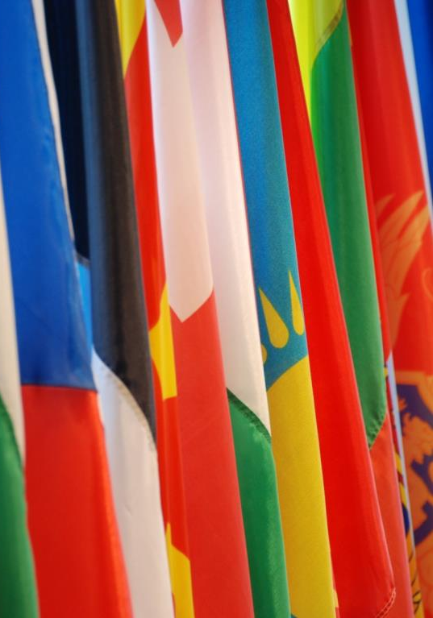

Thank you for your attention
Gabriel de Lastours
Associate Director,
Regional Head, SEMED, Energy EMEA
Tel: + 442073387647
Email: delastog@ebrd.com
www.ebrd.com

