Slide 1
EBRD – A brief overview
European Bank for Reconstruction and Development
Opportunities in SEMED
Ana Draskovic, Director, Head of EBRD Business Development
Monday, October 5th 2020
OFFICIAL USE

Slide 2
EBRD - An overview
  An international financial institution supporting the development of sustainable well-functioning market economies
Triple-A rating
(from all three main rating agencies (S&P, Moody’s and Fitch)
1991 | Established
1992 | Russia and 11 other members of the former Soviet Union join
2007 | The Czech Republic becomes the first country to “graduate” from the EBRD
2012 | Starts investing in Egypt, Jordan, Morocco and Tunisia
2016 | 25th anniversary; China becomes 67th member
2017 | Starts operating in Lebanon and in West Bank and Gaza
2018 | India and San Marino become members
2019 | Libya becomes a member
  Shareholding structure
Owned by 69 countries and 2 inter-governmental institutions
(the EU and EIB)
€30 billion Capital base
1. Includes European Community and European Investment Bank (EIB) each at 3%. Among other EU countries: France, Germany, Italy, and the UK each holds 8.6%
OFFICIAL USE
Notes:
Who we are
Strong, internationally recognised financial partner with long-term perspective
Operates on a commercial basis
Wide product, currency, tenor range
Facilitates inward and cross border investments in the region to enhance regional integration
Promotes through policy dialogue improvements in the investment climate and necessary sector reforms
Close working relationship with governments and shareholders
Extensive knowledge of local economy, business environment and practices based on 25 years experience and local presence in 36 countries
Structuring expertise and project preparation and implementation support available
Catalyst to access additional equity, debt and trade & project finance to both private and public sector clients
Objectives
To promote transition to modern and well-functioning markets by investing both in the private and state sectors
To encourage environmentally sound and sustainable development
To support better municipal services to improve people's lives
To support private sector development, privatisation and enterprise restructuring
To improve competitiveness and promote innovation to enhance energy and resource efficiency
To mobilise significant foreign direct investment

Slide 3
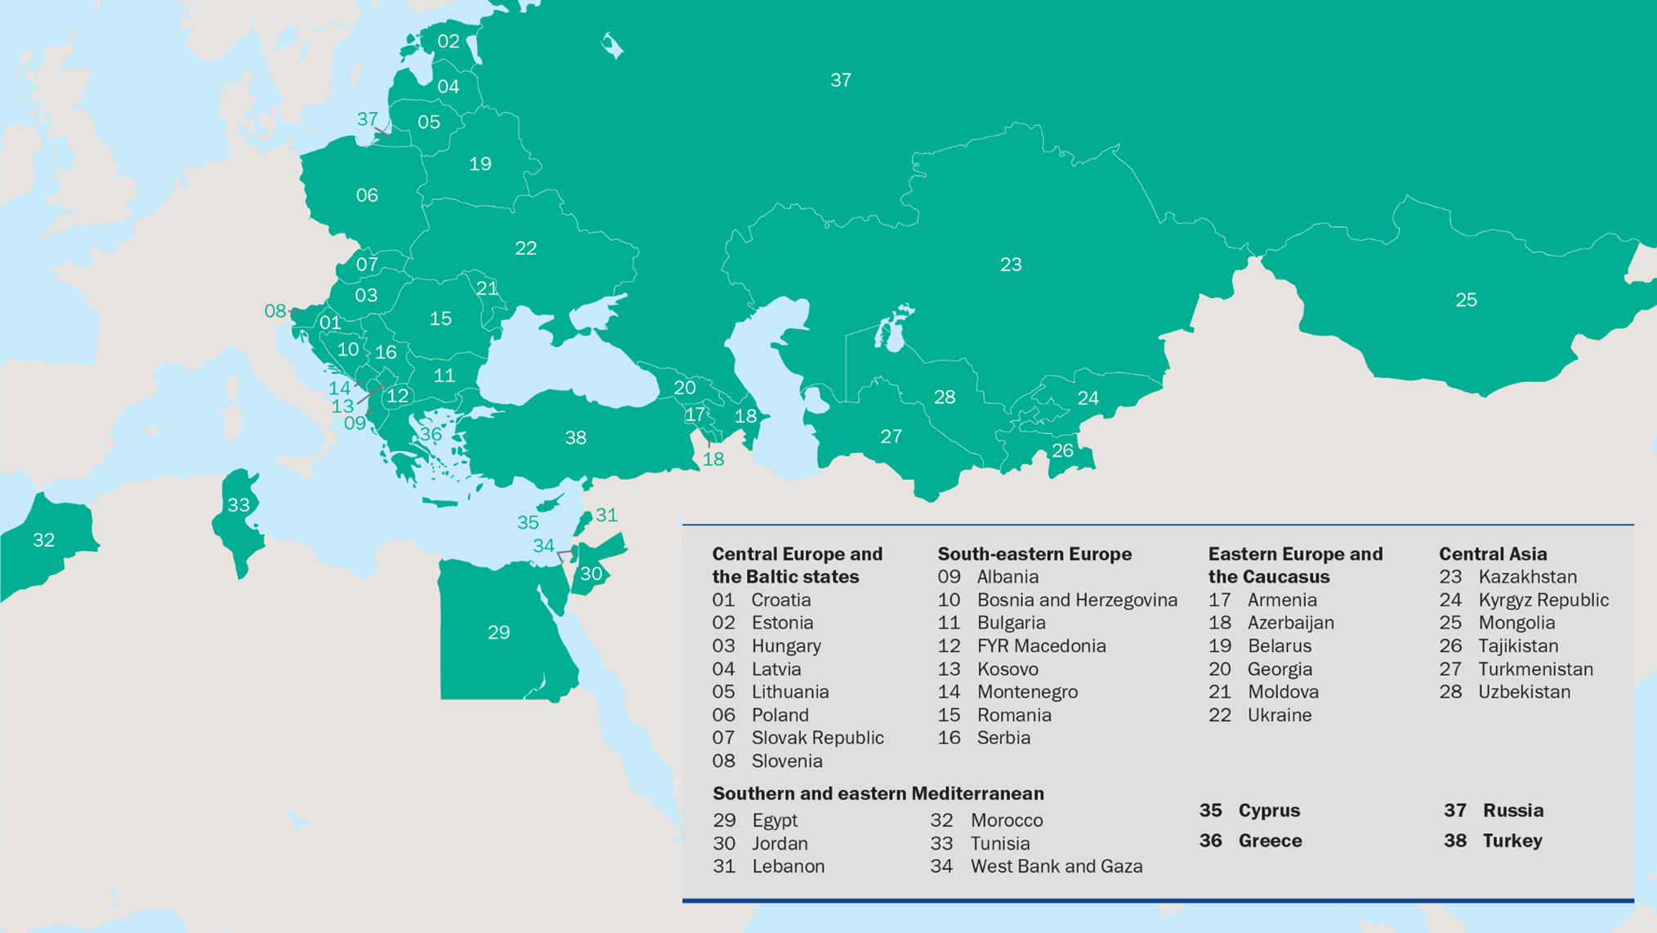
EBRD Countries of Operations
….across three continents
Not currently investing in Russia
Note: More than 40 Resident Offices and about 3,500 employees)

Slide 4
EBRD’s Investments
  Since 1991, EBRD invested over €142 billion in around 5,670 projects
  EBRD Top 10 investee countries in 2019 (€m)
  In 2019
€10 bn
1 | Egypt | 1,214
2 | Ukraine | 1,225
3 | Turkey | 1,002
4 | Poland | 833
5 | Kazakhstan | 685
6 | Greece | 571
7 | Uzbekistan | 517
8 | Serbia | 517
9 | Belarus | 391
10 | Romania | 372
452
projects
Private sector accounted
for share of
79%
Debt: 83%
Equity: 9%
Guarantee: 8%
  EBRD Portfolio (December 2019): € 46 billion
  Region
  Sector

Slide 5
EBRD Product Flexibility tailored to project needs
Debt (€1-300m)
Equity (€1-100m)
Guarantees
Typical size
€10mln +
€5-7mln + (less in less advanced countries)
Typically €50k – €50mln
Term
5-7 years (up to 10-15 years in case of infrastructure investments)
Typically from 3-7 years
1.5-2 (up to 3) years
Currency
Major foreign currencies as well as local currency
Approach
Finance up to 35% of the project (60% with syndication) for the company
Minority stake
Mainly through Trade Facilitation Programme
Structures
Senior, subordinated or convertible bonds
Project finance
Floating or fixed rates
Risk equity
Portage equity finance
Trade finance guarantees & cash advances
Applications
Greenfield/Brownfield, JVs,
Capex for expansion/modernization, including resource efficiency improvements
Ownership change: acquisition, consolidation, privatisation
PPPs, etc.
Working capital
Support to issuing banks in countries of operations
NB: Exact terms depend on specific needs and market conditions
OFFICIAL USE

Slide 6


Contacts
  Ana Draskovic
  Director - Head of EBRD Business Development
  Tel: Tel: +44 (0)20 7338 6000
  Email: draskova@ebrd.com
  Christian Hartung
  Manager, Business Development
  Tel. +44 (0) 20 7338 7505
  Email. hartungc@ebrd.com
  EBRD
  One Exchange Square
  London, EC2A 2JN
  United Kingdom
  www.ebrd.com
  Find us on social media
OFFICIAL USE

